Slide 1




Using Tele-Mentoring to Optimize Quality of Care and Quality of Life for Patients With Metastatic Kidney Cancer (TOQQ-RCC) ECHO Series
Facilitators: Elizabeth Wulff-Burchfield, MD,
Jennifer Klemp, PhD, MPH & Catie Knight, MPH
Session 4, July 16, 2021
Tyrosine Kinase Inhibitor (TKI) Toxicity Monitoring and Management
Guest Speaker: Grace Martin, PharmD, BCOP

Slide 2
Agenda
Time | Presentation | Presenter
12:00– 12:10 pm | Welcome, Overview of Session, and Introductions | Catie Knight, MPH
12:10 – 12:30 pm | Case Presentation | Elizabeth Wulff-Burchfield, MD
12:30 – 12:55 pm | Didactic & Discussion: TKI Toxicity, Monitoring and Management | Grace Martin, PharmD, BCOP Elizabeth Wulff-Burchfield, MD
12:55 – 1:00 pm | Wrap-up and Announcements | Catie Knight, MPH

Slide 3
It’s nice to meet you!
Please remember to sign-in by putting your name and email address in the Chat Box.
Notes:
Pause Share Screen and ask participants to introduce themselves.

Slide 4
Conflict of Interest Disclosure

Slide 5


You must sign in to Zoom with your full name (first and last) so we can confirm your attendance. After you sign in, if you discover you need to change your name to display your first and last name, click on the ‘Participants’ tab at the bottom of your screen where you see other meeting controls.
Continuing Education Statement
When the list of participants appears, hover your mouse over your name until you see the option to select ‘Rename’. Note—we will not be able to award continuing education credit or a certificate of attendance without your first and last name appearing on the Zoom attendance log.

Slide 6
Continuing Education Statement
Continuing education credit statements for TOQQ 6.11.21
Physicians: The University of Kansas Medical Center Office of Continuing Medical Education is accredited by the Accreditation Council for Continuing Medical Education (ACCME) to provide continuing medical education for physicians.
The University of Kansas Medical Center Office of Continuing Medical Education designates this live activity for a maximum of 1.0 AMA PRA Category 1 Credit(s)™. Physicians should claim only the credit commensurate with the extent of their participation in the activity.
APRN/RN: The University of Kansas Medical Center Area Health Education Center East is approved as a provider of CNE by the Kansas State Board of Nursing. This course offering is approved for 1.0 contact hours applicable for APRN or RN relicensure. Kansas State Board of Nursing provider number: LT0056-0749. Mary Beth Warren, MS, RN, Coordinator.
Social Work: The University of Kansas Medical Center Area Health Education Center East, as an approved provider of continuing education by the Kansas Behavioral Sciences Regulatory Board presents this offering for a maximum of 1.0 hour credit applicable for relicensure of LASWs, LBSWs, LMSWs and LSCSWs. Kansas Provider Number 12-002. Mary Beth Warren, MS, RN, coordinator.
Attendance requirement for nurses and social workers: Participants missing more than 10% of this offering will not receive continuing education credit. Partial credit will not be awarded.
Certificates of attendance are available to other participants upon completion of documentation of attendance and evaluation

Slide 7
Continuing Education Credit or Certificate of Attendance
ACTIVITY IDENTIFICATION/SIGN IN CODE:______
DEADLINE TO ENTER CODE AND COMPLETE EVALUATION: Thursday, ______, 2021 at 5:00 PM
Using your mobile phone, you can text the activity identification code to (828) 216-8114.
OR
Accessing www.eeds.com from a mobile device or PC and entering the activity identification code;
OR
Downloading the eeds mobile app (iOS, Android) and using the activity identification code to sign-in to events.

Slide 8
Funding Source
This project is funded by a Pfizer Independent Grant for Learning and Change with additional support from The University of Kansas Cancer Center and Masonic Cancer Alliance.

Slide 9

Recording
This ECHO session will be recorded for educational and quality improvement purposes.
By participating in this ECHO clinic, you are consenting to be recorded.

Slide 10




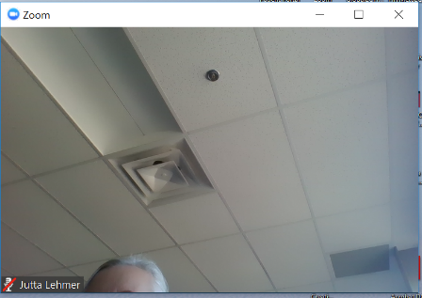
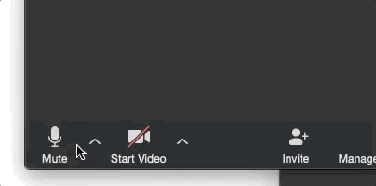


4
ECHO Clinic Tips
CAMERAS ON
Well-lit faces are
more engaging!
TESTING 1, 2, 3
Test both audio &
video in advance.
PARTICIPATE
Speak clearly, use the chat box, and actively engage.
MUTE YOURSELF
when you’re not speaking.

Slide 11

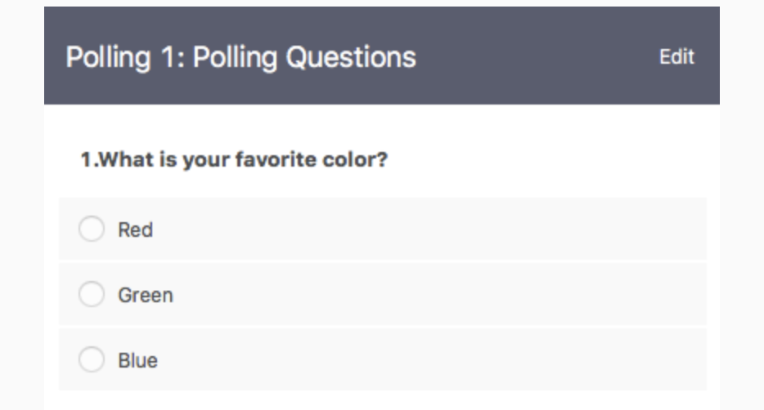
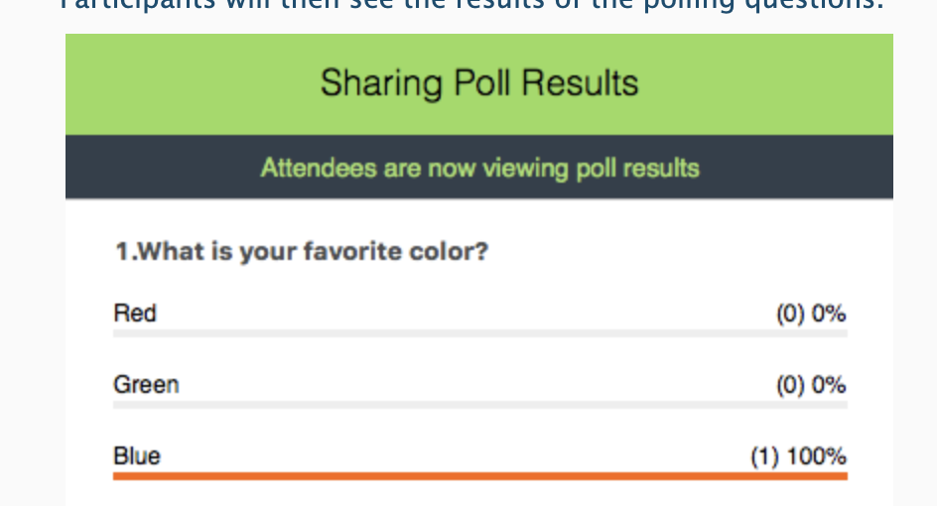

Polling Questions
Answer the poll question
See real-time results

Slide 12


Case Presentations & Patient Privacy
Goal: Protect patient privacy
Please only display or say information that does not identify a patient or that can not be linked to a patient.
Photos used in Case Study slides are freely-usable images from www.unsplash.com and not actual photos of known patients.
www.hipaa.com

Slide 13
Session 3 Learning Objective
Expand knowledge regarding the breadth of tyrosine kinase inhibitor toxicities, monitoring, and management.

Slide 14

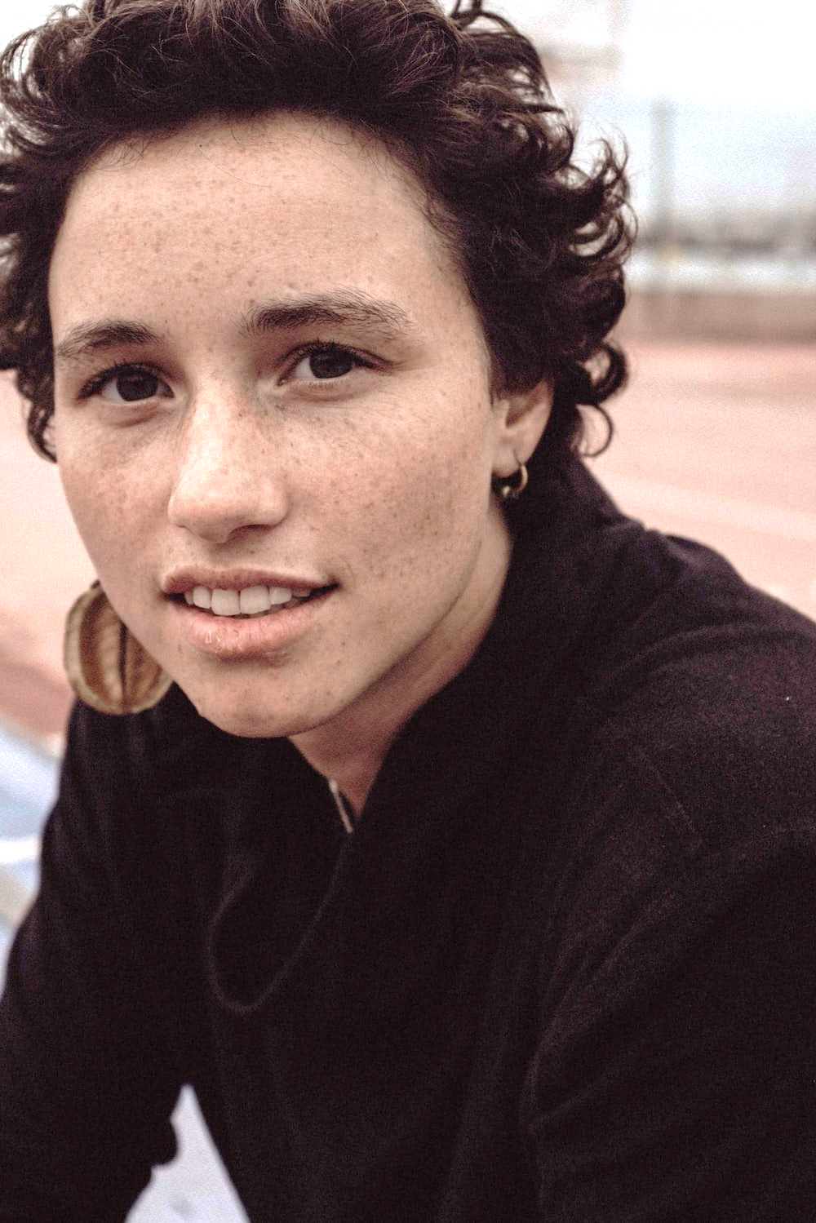
Case Study: “Mx. W”
46-year-old patient, Mx. W
Demographics
  Born genetically female, self identifies as genderqueer with they/them pronouns
  Working full time as a small business owner – owns a plant nursery
Comorbidities
  Relapsing-remitting multiple sclerosis, treated with Ofatumumab, currently quiescent
  History of Grave’s disease, now euthyroid on Levothyroxine
  Essential hypertension, managed by exercise and salt restriction
Diagnostic/treatment history
  Developed a chronic cough during the fall allergy season. Initially treated as allergic rhinitis but failed to improve.
  Neurologist ultimately ordered CT chest revealing innumerable pulmonary nodules, multiple lytic spine and rib lesions, and an 8 cm mass in the upper pole of right kidney.
  Biopsy of pulmonary nodule reveals clear cell kidney cancer.
Goals
  “I want to see my Godson (age 13) graduate from high school, but I need to be keep working. I take my responsibility to my employees seriously.”
Notes:
Rheumatologis grew concerned for RA-associated ILD or atypical infection, prompting the CT chest

Slide 15

Case Study, cont.
Mx. W now presents to establish medical oncology care
IMDC risk categorization: Intermediate-1 (based on de novo metastatic disease)
Medical decision-making discussions result in the choice of Cabozantinib as first-line therapy given intermediate risk disease with bone metastases in a person with active autoimmune disease
What is the mechanism of action for Cabozantinib and what is the patient experience with these agents based on mechanism?
Notes:
How do you prepare her and set appropriate expectations?

Slide 16
Tyrosine Kinase Inhibitors
Class of oral cancer therapy that underwent extensive development and clinical testing in the late 1990s and early 2000s
  Approved for multiple malignancies in the setting of advanced disease
While this class of oral cancer treatment is the focus of this session, many principles of treatment counseling, patient preparation, and monitoring apply to other classes (e.g. BCR-ABL1 TKI for CML, BRAF or MEK inhibitors for BRAF metastatic melanoma/lung/colorectal cancer, etc.).

Slide 17
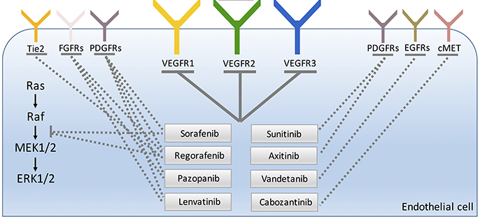
Tyrosine Kinase Inhibitors of Angiogenesis:
Mechanisms of Action
Comunanza V, et al. Front Cell Dev Biol. 2017;5:101. Figure 1; p.2.
Notes:
Tyrosine kinase inhibitors or TKIs are multikinase inhibitors that block the activity of several protein kinases associated with angiogenesis including VEGF receptors 1, 2, and 3.
Because these agents works intracellularly, it is thought that they may overcome resistance mechanisms to the other VEGF inhibitors
These drugs also block kinases involved in tumor microenvironment, fibroblast growth factor receptor (FGFR) and platelet-derived growth factor receptor-beta (PDGFR-B)
Blocking these multiple pathways results in inhibition of tumor growth.

Slide 18
Tyrosine Kinase Inhibitors of Angiogenesis
Agent | Indication(s) – advanced/incurable disease | First FDA Approval
Sorafenib | Hepatocellular carcinoma, renal cell carcinoma, differentiated thyroid cancer | 2005
Sunitinib | Gastrointestinal stromal tumor (GIST), pancreatic neuroendocrine tumor, renal cell carcinoma* | 2006
Pazopanib | Renal cell carcinoma, soft tissue sarcoma | 2009
Vandetanib | Medullary thyroid cancer | 2011
Axitinib | Renal cell carcinoma | 2012
Regorafenib | Colorectal cancer, gastrointestinal stromal tumor, hepatocellular carcinoma | 2012
Cabozantinib | Hepatocellular carcinoma, renal cell carcinoma, medullary thyroid cancer | 2012
Lenvatinib | Hepatocellular carcinoma, renal cell carcinoma, | 2015
Tivozanib | Renal cell carcinoma | 2021

Slide 19
Tyrosine Kinase Inhibitors of Angiogenesis:
Targets
Drug | Targets
Sorafenib | VEGFR1-3, PDGFR-β, Raf kinases, c-Kit, FLT-3, RET, RET/PTC
Sunitinib | VEGFR1-3, PDGFR-α & β, FLT3, CSF-1R, RET
Pazopanib | VEGFR1-3, PDGFR-α & β, FGFR-1 & 3, cKIT, Lck, cFms
Vandetanib | VEGF, EGFR, RET, BRK, TIE2, EPH, SRC
Axitinib | VEGFR1-3
Regorafenib | VEGFR1-3, PDGFR-α & β, KIT, RET, FGFR1 & 2, TIE2, DDR2, TrkA, Eph2A, RAF-1, BRAF, SAPK2, PTK5, Abl
Cabozantinib | VEGFR1-3, AXL, FLT-3, KIT, MER, MET, RET, ROS1, TIE2, TRKB, TYRO3
Lenvatinib | VEGFR1-3, FGFR1-4, PDGFR-α, KIT, RET
Tivozanib | VEGFR1-3, cKIT, PDGFR-α & β
Notes:
The multitarget activity of tyrosine kinase inhibitors or TKIs makes them effective for many types of cancer. The predominant cancer types treated with VEGF inhibitors are hepatocellular carcinoma, renal cell carcinoma, and thyroid cancer.
Notice that VEGF is a target for all of these TKIs. That means they all have a risk of the adverse effects that are common with VEGF inhibitors like bevacizumab including hypertension, wound healing effects, and proteinuria; however, because they have additional targets, we must also monitor for additional side effects.
Pop-up for Abbreviations:
BRK: protein tyrosine kinase 6 (Note to reviewers: checked multiple sources and this is what it is)
cFms: transmembrane glycoprotein receptor tyrosine kinase
CSF: colony-stimulating factor type 1
DDR2: discoidin domain receptor 2
EGFR: epidermal growth factor receptor
EphA2: ephrin type A receptor 2
FGFR: fibroblast growth factor receptor
FLT: FMS-like tyrosine kinase-3
Lck: lymphocyte-specific protein tyrosine kinase
PDGFR: platelet-derived growth factor receptor
PTC: papillary thyroid carcinoma
RET: rearranged during transfection
SAPK2: stress activated protein kinase-2
TrkA: tropomyosin receptor kinase A
VEGF: vascular endothelial growth factors
VEGFR: vascular endothelial growth factor receptor
Note for reviewers: The following were not included in abbreviations because they are the name of the receptor tyrosine kinase or gene.
c-Kit, BRAF, KIT, PTK5, SRC, TIE2, YRO3

Slide 20
Case Study, cont.
Mx. W presents for a treatment counseling visit with a plan to initiate Cabozantinib at a dose of 60 mg by mouth daily and you dive into the discussion about side effects.
What should be highlighted in this discussion and how can you prepare patients for success on these agents?

Slide 21
Tyrosine Kinase Inhibitors of Angiogenesis: Adverse Effects
QTc prolongation
Boxed label warning for vandetanib with a required REMS program (www.caprelsarems.com) due to prolonged QT interval, Torsades de pointes, and sudden death that occurred in patients receiving vandetanib
Do not initiate in patients with electrolyte imbalances or long QT syndrome
Check the prescribing information for the specific recommendations for ECG monitoring for these agents, and correct electrolyte abnormalities prior to and during therapy
Proteinuria
Monitor urine protein, discontinue if proteinuria ≥ 2 grams in 24 hours
Hemorrhage
Boxed label warning for cabozantinib for medullary thyroid cancer
Monitor for signs and symptoms of bleeding
Voice changes
Often described as hoarseness
Most common with sorafenib, axitinib, regorafenib, and lenvatinib
Hypertension
VEGF inhibitor related HTN is dose related and can usually be controlled by antihypertensive agents
Follow the drug-specific recommendations regarding the frequency of blood pressure monitoring
Treat hypertension and temporarily suspend VEGF therapy for severe hypertension that is not controlled with medical management
The European Society of Cardiology recommends ACE inhibitors, ARBs, and dihydropyridine CCBs as first-line therapy for VEGF inhibitor induced hypertension
Non-dihydropyridine CCBs (verapamil and diltiazem) should be avoided due to drug-drug interactions
Caution should be used with diuretics as patients are often receiving concurrent chemotherapy and volume depletion should be avoided
Perforations and fistulas
Rare but serious adverse event
Boxed label warning for cabozantinib for medullary thyroid cancer
Discontinue in patients who develop a perforation or fistula
Thyroid disorders
Hypothyroidism, hyperthyroidism, and thyroiditis may occur
Monitor thyroid function at baseline and monitor for signs and symptoms of thyroid dysfunction during treatment
Check the prescribing information for additional monitoring, as some require TSH levels as often as every 4 weeks
Hand-foot skin reaction (HFSR)
Dose-limiting toxicity of multikinase inhibitors
Common in patients taking regorafenib, cabozantinib, sorafenib, axitinib, and sunitinib
High-grade HFSR is reported in over 20% of patients taking regorafenib
Hepatotoxicity
The majority of TKIs induce hepatotoxicity
Cases of fatal hepatotoxicity have been noted in clinical trials and in post-marketing experience
There is a hepatotoxicity boxed label warning for regorafenib, sunitinib, and pazopanib
Patients should be carefully monitored for TKI-induced hepatoxicity
Heart failure
New onset or worsening of existing heart failure
Monitor for signs and symptoms of heart failure and monitor the LVEF as recommended by the specific agent’s prescribing information
Hepatotoxicity
QTc prolongation
Hand-foot skin reaction
Perforations and fistulas
Thyroid disorders
Hemorrhage
Heart failure
Voice Changes
Hypertension
Proteinuria
Notes:
References
Regorafenib prescribing information. https://www.accessdata.fda.gov/drugsatfda_docs/label/2019/203085s010lbl.pdf
Sunitinib prescribing information. https://www.accessdata.fda.gov/drugsatfda_docs/label/2019/021938s036lbl.pdf
Pazopanib prescribing information. https://www.accessdata.fda.gov/drugsatfda_docs/label/2017/022465s024s025lbl.pdf
Cabozantinib prescribing information. https://www.accessdata.fda.gov/drugsatfda_docs/label/2019/208692s003lbl.pdf
Vandetanib prescribing information. https://www.accessdata.fda.gov/drugsatfda_docs/label/2018/022405s014lbl.pdf
Axitinib prescribing information. https://www.accessdata.fda.gov/drugsatfda_docs/label/2018/202324s008lbl.pdf
Sorafenib prescribing information. https://www.accessdata.fda.gov/drugsatfda_docs/label/2018/021923s020lbl.pdf
Pop-up text for Heptotoxicity button:
Hepatotoxicity
The majority of TKIs induce hepatotoxicity
Cases of fatal hepatotoxicity have been noted in clinical trials and in post-marketing experience
There is a heptotoxicity boxed label warning for regorafenib, sunitinib, and pazopanib
Patients should be carefully monitored for TKI-induced hepatoxicity
Pop-up text for Hand-foot skin reaction button:
Hand-foot skin reaction (HFSR)
Dose-limiting toxicity of multikinase inhibitors
Common in patients taking regorafenib, cabozantinib, sorafenib, axitinib, and sunitinib
High-grade HFSR is reported in over 20% of patients taking regorafenib
Pop-up text for Thyroid disorders button:
Thyroid disorders
Hypothyroidism, hyperthyroidism, and thyroiditis may occur
Monitor thyroid function at baseline and monitor for signs and symptoms of thyroid dysfunction during treatment
Check the prescribing information for additional monitoring, as some require TSH levels as often as every 4 weeks
Pop-up text for Heart failure button:
Heart failure
New onset or worsening of existing heart failure
Monitor for signs and symptoms of heart failure and monitor the LVEF as recommended by the specific agent’s prescribing information
Pop-up text for QTc prolongation button:
QTc prolongation
Boxed label warning for vandetanib with a required REMS program (www.caprelsarems.com) due to prolonged QT interval, Torsades de pointes, and sudden death that occurred in patients receiving vandetanib
Do not initiate in patients with electrolyte imbalances or long QT syndrome
Check the prescribing information for the specific recommendations for ECG monitoring for these agents, and correct electrolyte abnormalities prior to and during therapy
Pop-up text for Perforations and fistulas button:
Perforations and fistulas
Rare but serious adverse event
Boxed label warning for cabozantinib for medullary thyroid cancer
Discontinue in patients who develop a perforation or fistula
Pop-up text for Hemorrhage button:
Hemorrhage
Boxed label warning for cabozantinib for medullary thyroid cancer
Monitor for signs and symptoms of bleeding
Pop-up text for Voice changes button:
Voice changes
Often described as hoarseness
Most common with sorafenib, axitinib, regorafenib, and lenvatinib
The general side effects of tyrosine kinase inhibitors with angiogenesis targets are provided. Keep in mind, all the VEGF adverse effects still apply for these agents as well since that is one of their targets.

Slide 22



An Ounce of Prevention
While not prospectively evaluated, we have developed a patient-facing symptom prevention/mitigation/communication strategy for VEGFR TKIs.
  Provided verbally, and in “after visit” summary in writing or via EHR portal.
Hand-foot skin reaction
  Use exfoliation to remove any visible calluses before initiating treatment.
  Avoid exposure of the palms/soles to significant heat or friction. If this cannot be avoided, we recommend wearing gloves when exposing the hands to heat (e.g. washing dishes) or friction (e.g. while gardening).
  Begin moisturizing with over-the-counter hand cream and apply to the palms of the hands and soles of the feet twice daily every day – no exceptions.
  Obtain a hand cream containing 10% urea (such as Udderly Smooth®); be prepared to apply this up to twice daily to any thick or callused areas that develop on treatment
  Be prepared to notify us of any erythematous, tender/painful, blistered, or ulcerated areas at the first sign so that we can prescribe a steroid cream.
    Emphasize that this will allow us to treat the side effect and that it does not put their treatment at risk if we catch this early.

Slide 23
An Ounce of Prevention, cont.
Hypertension
  If possible, obtain an automated blood pressure cuff (or identify a pharmacy with a cuff in the store) and begin measuring BP three times per week. Plan to continue this for 2-4 weeks after each dose change of TKI.
  Keep a diary of BP values and provide this list to us once per week via the portal or phone.
  Notify us immediately if BP > 140/90 (either number) so that we can manage blood pressure.
    Emphasize that this will allow us to treat the side effect and that it does not put their treatment at risk if we catch this early.
Diarrhea
  Obtain a bottle of Loperamide 2 mg pills to keep at home in case this is needed to manage diarrhea.
  If loose stools become recurrent, our typical recommendation would be to take 4 mg after the first loose stool and then 2 mg after each subsequent loose stool with max of 8 pills (16 mg) over 24 hours.

Slide 24
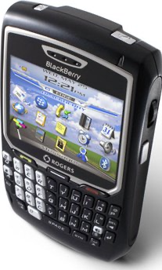
A Word About Management:
Hand-Foot Skin Reaction
Differs from hand-foot syndrome (palmar-plantar erthyrodyesthesia) associated with cytotoxic chemotherapy
TKI-Associated Hand-Foot Skin Reaction | Palmar-Plantar Erythrodysethesia (PPE) or Hand-Foot Syndrome
Quick onset (2 -4 weeks) | Begins weeks to months after initiating treatment
Callused areas that can be erythematous and painful | Diffuse / symmetrical distribution
Occurs at pressure points: There are reports of this reaction on areas of friction from amputated limbs, and even on the side of thumbs during the BlackberryTM era! | Scaling and redness

Slide 25
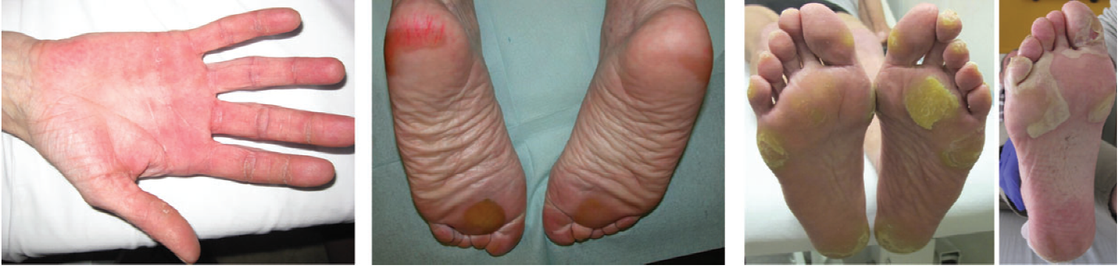

Management: Hand-Foot Skin Reaction
Grade 1
Minimal skin changes or dermatitis without pain
Maintain current dose and implement supportive care
Grade 2
Painful skin changes that limit activities of daily living
Decrease by one dose level and initiate supportive care
  If no improvement, interrupt for at least 1 week
Grade 3
Severe skin changes with pain that limit self-care activities of daily living
Interrupt therapy for at least a week and until toxicity resolves to grade 0 – 1.
  When resuming treatment, decrease dose by one dose level
Grade 1
Grade 2
Grade 3
McLellan B, et al. Ann Oncol. 2015;26(10):2017-2026. Figure 1; p.2021.
Notes:
Reference: Please make this PDF available as a supplemental resource
McLellan B, et al. Ann Oncol. 2015;26(10):2017-2026. Figure 1; p.2021.
Pop-up text for Grade 1 button:
Minimal skin changes or dermatitis without pain
Maintain current dose and implement supportive care
Pop-up text for Grade 2 button:
Painful skin changes that limit activities of daily living
Decrease by one dose level and initiate supportive care. If no improvement, interrupt for at least 1 week
Pop-up text for Grade 3 button:
Severe skin changes with pain that limit self-care activities of daily living
Interrupt therapy for at least a week and until toxicity resolves to grade 0–1. When resuming treatment, decrease dose by one dose level
Hand-foot skin reaction observed with tyrosine kinase inhibitors is distinct from hand-foot syndrome (palmar-plantar erthyrodyesthesia) associated with traditional chemotherapy. It’s onset is fairly soon after initiating treatment, usually within the first 2-4 weeks, and it causes a painful sensation, erythema, and hyperkeratosis at pressure points. When I am describing it to a patient, I tell them it typically affects areas of friction on the hands and feet especially in areas where they normally have calluses.
This is different from hand-foot syndrome which usually has a symmetrical distribution and causes scaling and redness that occurs weeks to months after starting treatment.

Slide 26
Hand-Foot Skin Reaction:
Supportive Measures
Purpose | Intervention | Timing
Control of calluses | Manicure/pedicure to remove hyperkeratotic skin Pumice stone use for callus removal Avoid pressure points Avoid items that rub, pinch, or create friction | Before initiating TKI
Moisturizers | Nonurea-based creams or ointments | Apply liberally when needed
Keratolytic creams | 10-40% urea based creams 5-10% salicylic acid | Use sparingly and only to hyperkeratotic areas
Pain control | Topical analgesics (lidocaine 2-4%) | As needed
Management of grade 2-3 symptoms | High potency topical steroids (clobetasol, betamethasone, halobetasol) | Twice daily
Cushioning/ protection of tender areas | Use socks/gloves to cover moisturized areas Wear well-padded footwear Use insole cushions or inserts | As needed
McLellan B, et al. Ann Oncol. 2015;26(10):2017-2026.
Notes:
Reference: McLellan B, et al. Ann Oncol. 2015;26(10):2017-2026.
The most important thing you can do to prevent hand-foot skin reaction is to examine the condition of the patient’s hands and feet before initiating therapy and suggest that they get a manicure, pedicure, and use a pumice stone before they start.
Controlling calluses can really help prevent this toxicity. They should keep their hands and feet well moisturized and if they start to develop hand-foot skin reaction, they could use a urea-based cream to help break down hyperkeratotic areas.
Pain control with topical analgesics may be required, and for grade 2-3 symptoms, topical steroids may be beneficial for their anti-inflammatory effect. Patient should also protect their feet by wearing comfortable, well-fitting shoes. Sorry, no flip flops!
Like most adverse effects, its always best to do everything we can to prevent hand-foot skin reaction upfront rather than waiting until it happens to treat! In more severe cases, temporary dose reductions or treatment interruption may be required.

Slide 27
Let’s Take a Poll!
What do you observe to be the most challenging side effect among VEGFR TKIs?
                Hand-foot skin reaction
                Hypertension
                Proteinuria
                Stomatitis
                Thyroid dysfunction

Slide 28

Case Study, cont.
Mx. W finally receives her supply of Cabozantinib after it is shipped to her home from the specialty pharmacy required by her insurance.
When starting a TKI (or any oral cancer therapy), what are best practices for promoting safety, quality of life, and adherence?
Unmute your mic to chime in or share your thoughts in the Chatbox!

Slide 29
Oral Chemotherapy Practices at KU
Discussion between patient and provider about new treatment
Consent obtained
Prescription signed and released by provider
Sent to oncology pharmacist queue for review
Pharmacist completes initial assessment and enrolls in monitoring program
Verified by oncology pharmacist and sent to pharmacy
Notes:
Other factors that can influence choice of treatment – cost of oral cancer medications
Even if we are able to identify the ideal treatment regimen for a patient, the cost of treatment, particularly for oral medications, can create barriers.
In your practice, have you encountered circumstances when patients were unable to take recommended treatments due to the cost of oral medications (for any cancer, not just kidney cancer)?
Yes
No
If you’ve been able to overcome some of these barriers, please share with us some of your strategies in the chat box.

Slide 30
Oral Chemotherapy Monitoring
Oncology pharmacist completes oral chemotherapy patient education
Toxicity check completed ~2 weeks after start date
Reassessment completed every 3 months to every year depending on risk category of drug

Slide 31
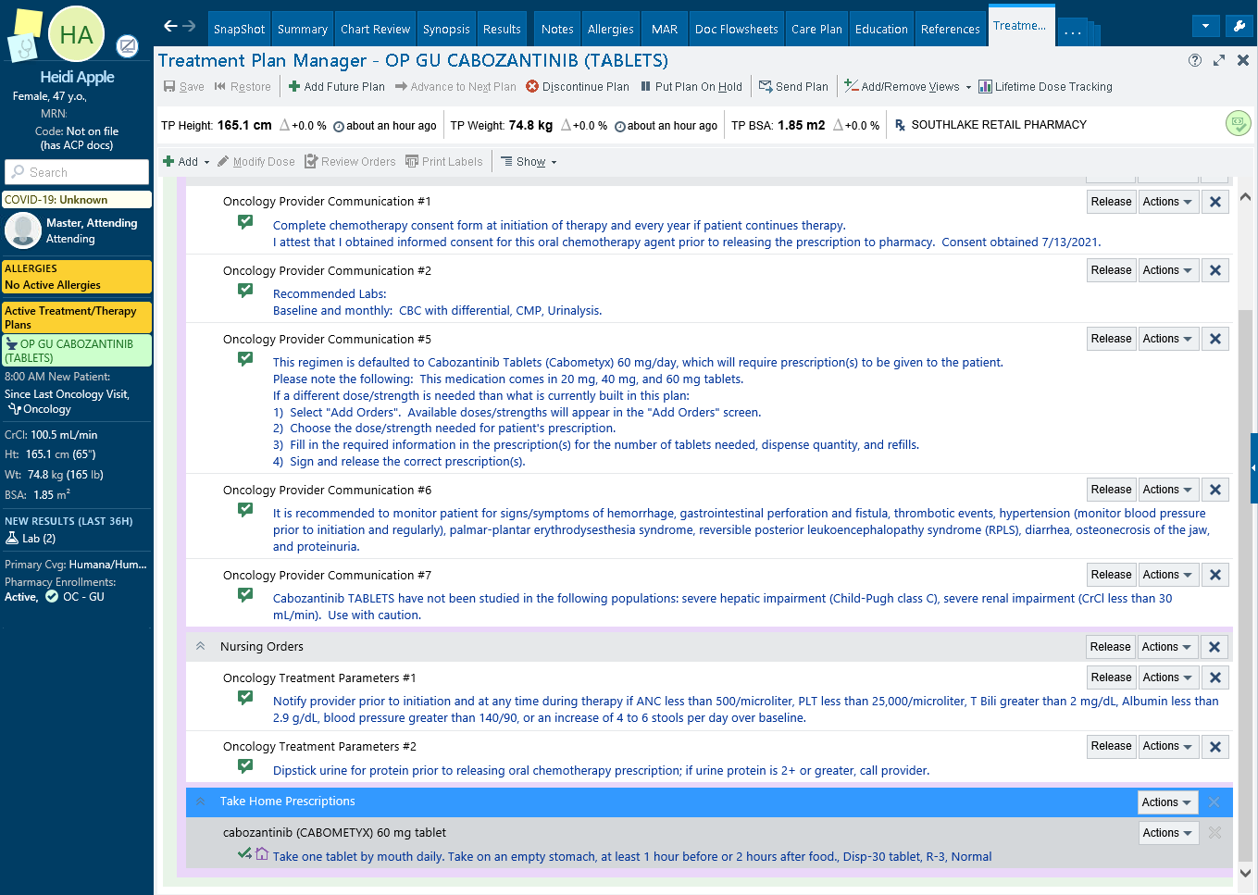
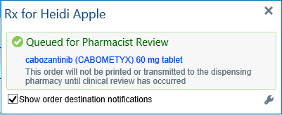
1. Consent obtained
2. Signed and released by provider

Slide 32
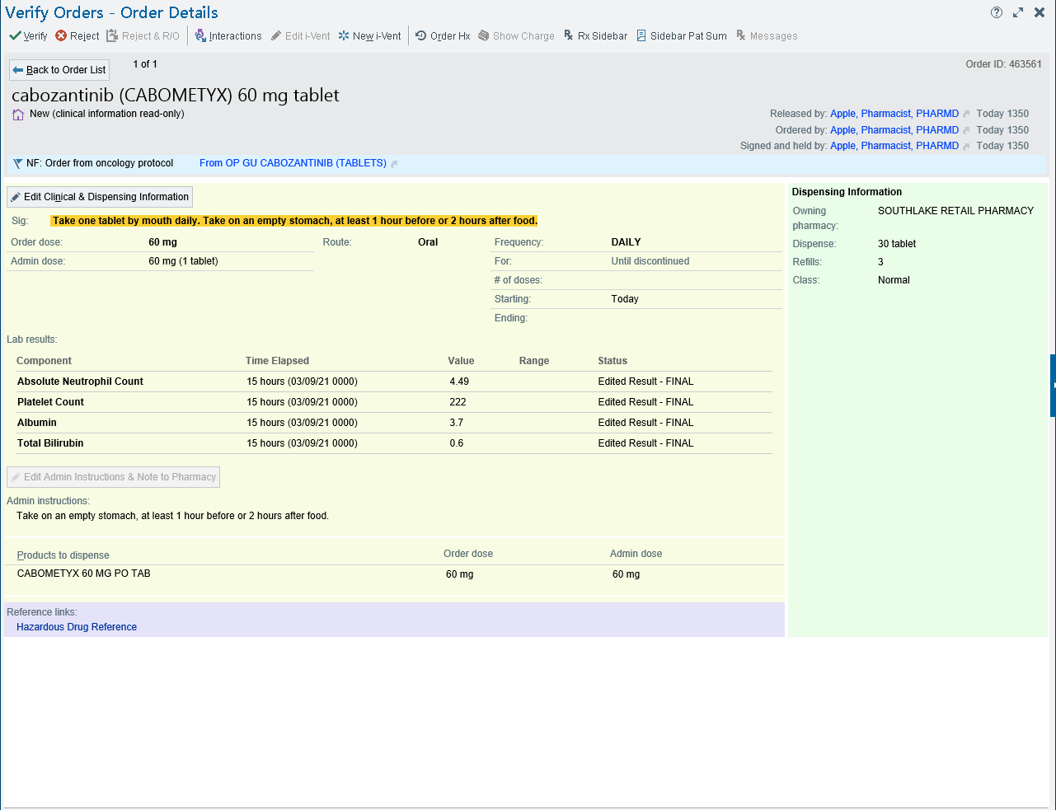
3. Oncology pharmacist reviews prescription, completes initial assessment note, enrolls in OC monitoring program, and verifies prescription to send to the pharmacy

Slide 33
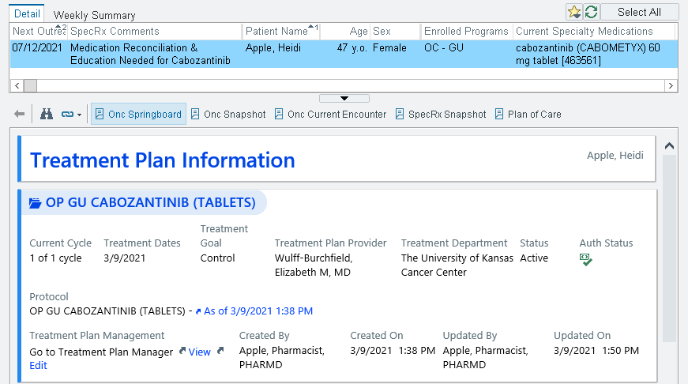
4. Oncology pharmacist sets up time to speak to patient for oral chemotherapy education. Each oncology pharmacist shift has their own patient list with a next outreach date for education, toxicity checks, and reassessments.

Slide 34

KU Specialty Pharmacy Protocol
New prescriptions are sent to KU Specialty Pharmacy
Pharmacy Patient Advocates (PPAs) call patients with copay information and have a goal of a $0 copay
PPAs pursue copay cards, grants, foundation assistance, and drug company medication assistance to help with coverage if patients are unable to afford their medication
PPAs coordinate with the oncology pharmacist if they run into any concerns or need assistance from the clinic

Slide 35
Let’s Take a Poll!
Does your practice engage in toxicity monitoring between clinic visits?
Yes
No
If yes, please share in the chat box who does the monitoring, their clinical role, and the basic procedure.

Slide 36
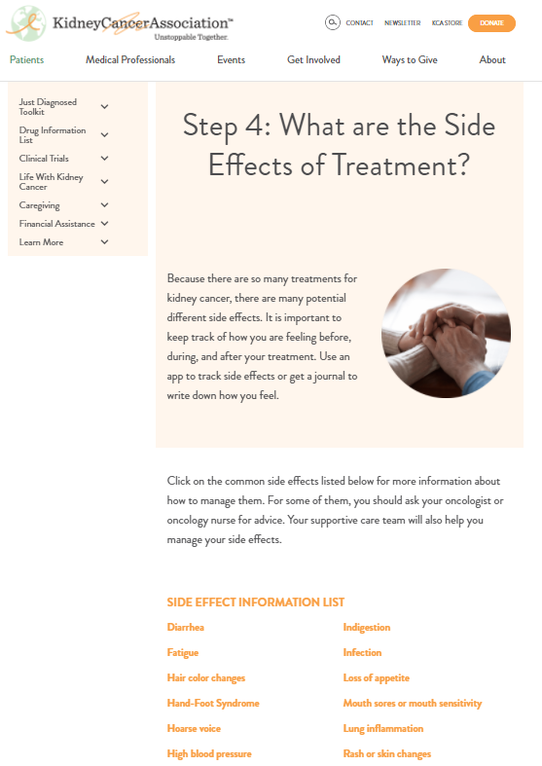
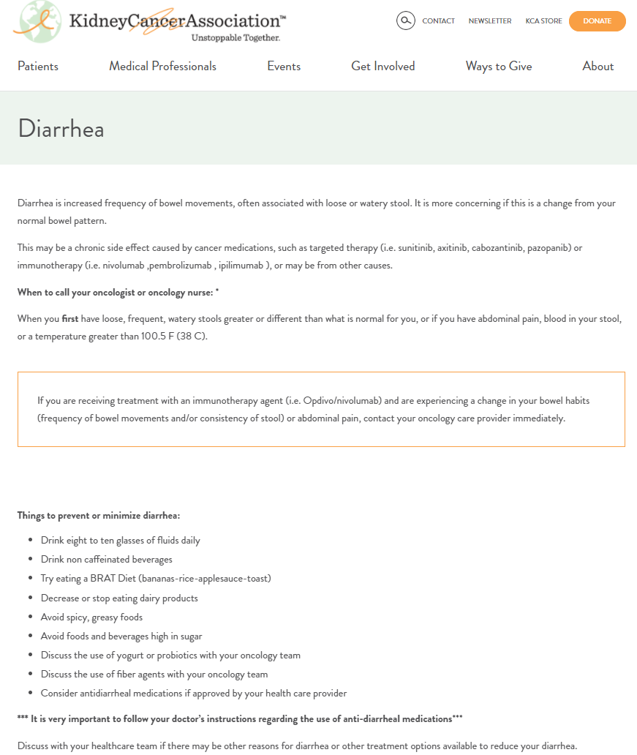


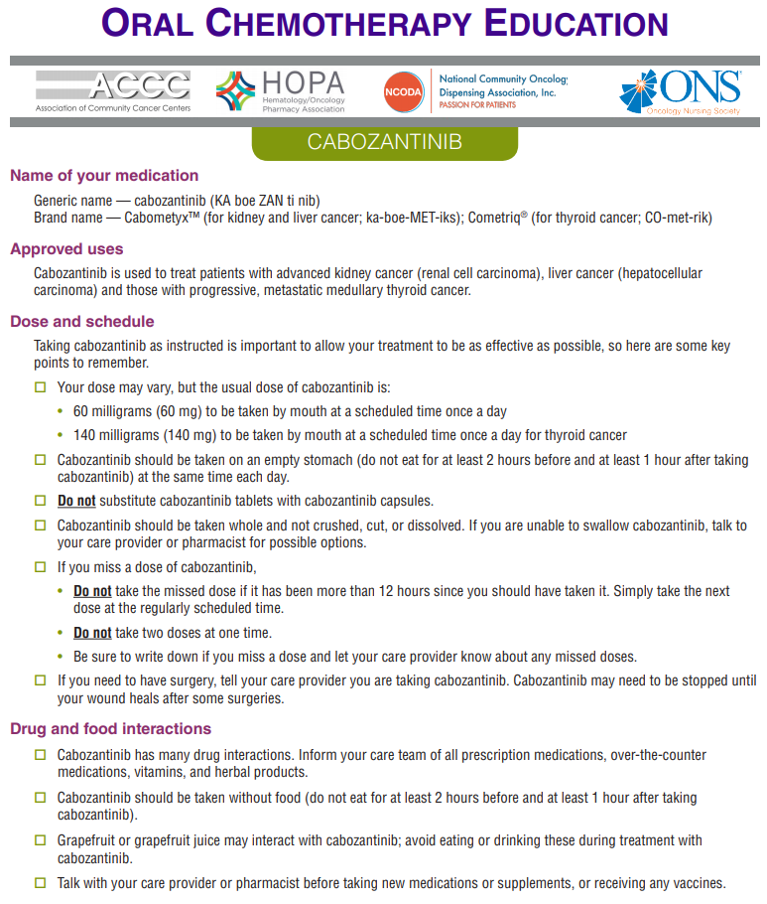
Additional Patient Resources
Kidney Cancer Association – "Just Diagnosed Toolkit“
Oral Chemotherapy Education – oralchemoedsheets.com

Slide 37

Discussion & Questions

Slide 38

Announcements
Join us for the next ECHO session on Friday, August 13th at Noon
Toxicity Education, Monitoring, and Management Regarding Combination Immunotherapy or TKI-Immunotherapy Regimens for RCC
Special Guest: Jennifer Heins, PA
Volunteers Needed for Qualitative Interview
Maryellen Potts, PhD is conducting a sub-study for TOQQ-RCC to explore clinician perspectives of provider-to patient education regarding ICI therapy and toxicity. Interviews take about 15-20 minutes and compensation for your time is provided.
Email Catie Knight at cknight2@kumc.edu for more information.
Notes:
Sub-study participant compensation = $50 Amazon gift card.

Slide 39

Wrap-Up
Don’t forget to sign-in by putting your name in the chat box.
Activity Identification Code: _______
Due Date: Thursday, _________, 2021 at 5:00 PM
Text the activity identification code to (828) 216-8114 or www.eeds.com
A recording of the previous session didactics and toolbox items are now available on the MCA website on the Telementoring page. www.masoniccanceralliance.org

