Slide 1




Using Tele-Mentoring to Optimize Quality of Care and Quality of Life for Patients With Metastatic Kidney Cancer (TOQQ-RCC) ECHO Series
Facilitators: Elizabeth Wulff-Burchfield, MD & Catie Knight, MPH
Session 1 Topic: Patient Assessment and Treatment Choice
Guest Speaker: Jessica Hamilton, PhD

Slide 2
Agenda
Time | Presentation | Presenter
12:00– 12:10 pm | Welcome Introductions Housekeeping | Catie Knight, MPH
12:10 – 12:30 pm | Case Presentation | Elizabeth Wulff-Burchfield, MD
12:30 – 12:55 pm | Didactic: Patient Assessment and Treatment Choice Discussion and Questions | Jessica Hamilton, PhD Elizabeth Wulff-Burchfield, MD
12:55 – 1:00 pm | Homework Wrap-up Announcements | Catie Knight, MPH

Slide 3
It’s nice to meet you!
Notes:
Pause Share Screen and ask participants to introduce themselves.

Slide 4
Conflict of Interest Disclosure
The following presenters and/or planning committee members do not have any relevant financial relationships with any proprietary entities producing, marketing, re-selling, or distributing healthcare goods or services consumed by, or used on patients related to the content of their presentation:
Jessica Hamilton, PhD; Catie Knight, MPH; Mary Beth Warren, MS, RN,
The following presenters and planning committee member has disclosed potentially relevant financial relationships with proprietary entities producing, marketing, re-selling or distributing healthcare goods or services consumed by, or used on, patients:
Elizabeth Wulff-Burchfield, MD received consulting fee from Astellas, Bristol Myers Squibb and Exelixis; owns stock in Immunomedics and Nektar.
Jennifer Klemp, PhD, MPH received honoraria from Novartis, Pfizer Oncology and Astra Zeneca

Slide 5

Continuing Education Statement
Physicians: The University of Kansas Medical Center Office of Continuing Medical Education is accredited by the Accreditation Council for Continuing Medical Education (ACCME) to provide continuing medical education for physicians.
The University of Kansas Medical Center Office of Continuing Medical Education designates this live activity for a maximum of 1.0 AMA PRA Category 1 Credit(s)™. Physicians should claim only the credit commensurate with the extent of their participation in the activity.
APRN/RN: The University of Kansas Medical Center Area Health Education Center East is approved as a provider of CNE by the Kansas State Board of Nursing. This course offering is approved for 1.0 contact hours applicable for APRN, or RN re-licensure. Kansas State Board of Nursing provider number: LT0056-0749. Mary Beth Warren, MS, RN, Coordinator.
Social Work: The University of Kansas Medical Center Area Health Education Center East, as an approved provider of continuing education by the Kansas Behavioral Sciences Regulatory Board presents this offering for a maximum of 1.0 hour credit applicable for re-licensure of LASWs, LBSWs, LMSWs and LSCSWs. Kansas Provider Number 12-002. Mary Beth Warren, MS, RN, coordinator.
Attendance requirement for nurses and social workers Participants missing more than 10% of this offering will not receive continuing education credit.
Certificates of attendance are available to other participants upon completion of documentation of attendance and evaluation.

Slide 6
Continuing Education Credit & Certificate of Attendance
ACTIVITY IDENTIFICATION/SIGN IN CODE: 02hiss
DEADLINE TO ENTER CODE AND COMPLETE EVALUATION: Thursday, April 22, 2021 at 5:00 PM
Using your mobile phone, you can text the activity identification code to (828) 216-8114.
OR
Accessing www.eeds.com from a mobile device or PC and entering the activity identification code;
OR
Downloading the eeds mobile app (iOS, Android) and using the activity identification code to sign-in to events.

Slide 7
Funding Source
This project is funded by a Pfizer Independent Grant for Learning and Change with additional support from The University of Kansas Cancer Center and Masonic Cancer Alliance.

Slide 8

Recording
This ECHO session will be recorded for educational and quality improvement purposes.
By participating in this ECHO clinic, you are consenting to be recorded.

Slide 9




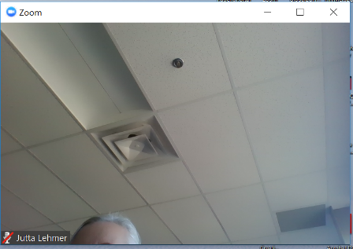



4
ECHO Clinic Tips
CAMERAS ON
Well-lit faces are
more engaging!
TESTING 1, 2, 3
Test both audio &
video in advance.
PARTICIPATE
Speak clearly, use the chat box, and actively engage.
MUTE YOURSELF
when you’re not speaking.

Slide 10

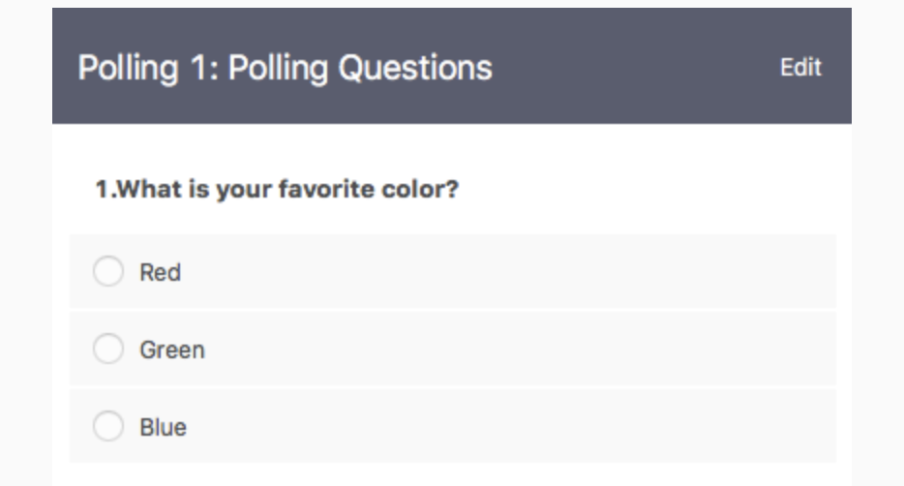
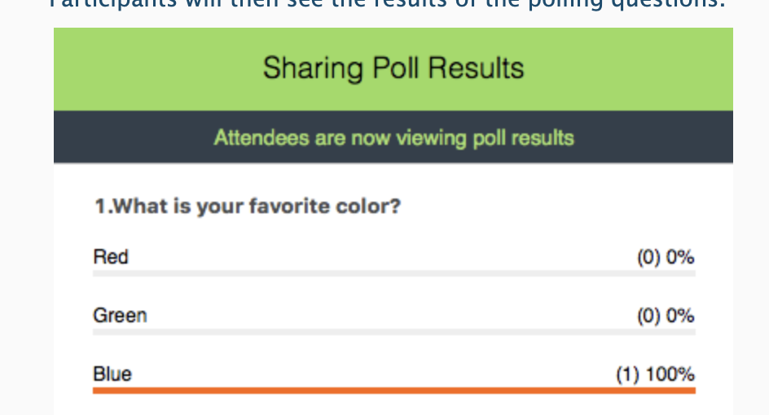

Polling Questions
Answer the poll question
See real-time results

Slide 11

Session 1 Learning Objective
Understand and apply tools for identifying physical and psychosocial effects of cancer and/or treatment.

Slide 12

Case Presentations & Patient Privacy
Goal: Protect patient privacy
Please only display or say information that does not identify a patient or that can not be linked to a patient.
Photos used in Case Study slides are freely-usable images from www.unsplash.com and not actual photos of known patients.
www.hipaa.com

Slide 13

A Tale of Two Patients: Case Study A
63-year-old patient, “Mr. A”
Demographics
  Born as genetically male, self identifies as male with he/him pronouns
  Mechanical engineer for local firm, was planning to work to age 70
  Married, spouse works as paralegal
Comorbidities:
  Hyperlipidemia, manages with diet
Diagnosis history
  Previously ran marathons, had to scale back because of increasing dyspnea
  PCP checked labs showing new, mild anemia with HgB of 13, CXR with multiple pulmonary nodules
  CT chest revealed multiple non-calcified pulmonary nodules, right upper pole renal mass with tumor thrombus
  CT a/p revealed 8 cm kidney mass, no lymphadenopathy or other overt metastatic disease
  Percutaneous biopsy – clear cell RCC, WHO grade 3
Goals
  To keep working
  To avoid side effects, especially any that could make running (his favorite hobby) difficult

Slide 14

A Tale of Two Patients: Case Study B
59-year-old patient, “Mr. B”
Demographics
  Born as genetically male, self identifies as male with he/him pronouns
  Worked as maintenance supervisor for local school district, not able to work due to pain and fatigue
  Divorced, 1 living sibling, who is incarcerated
Comorbidities:
  Type II diabetes, HgB a1c 7.5%, hypertension, hypothyroidism
Diagnosis history
  First developed low back pain, followed 2 months later with left flank pain and hematuria
  X-ray of lumbar spine shows lytic lesion at L2
  MRI of lumbar spine redemonstrates L2 lesion and scattered lytic metastases as well as L lower pole kidney mass, bulky retroperitoneal lymphadenopathy
  CT c/a/p revealed scattered pulmonary nodules, hilar lymphadenopathy, redemonstrated kidney mass, retroperitoneal LAD, scattered osseous mets; labs show Ca 11.1
  Biopsy shows clear cell renal cell carcinoma, WHO grade 3
Goals
  To improve pain
  To live to see his eldest grandson (now 17) graduate from college

Slide 15

Where to begin? And what path to take?
In addition to different manifestations of their cancer, these patients have different goals, different psychosocial circumstances, and likely different global needs.
Neither elucidated any particular needs, so how do we know how to best support them and guide their treatment?

Slide 16

Crossing the Starting Line
Comprehensive care for new patients with advanced cancer is multifaceted
Some initial tasks relate to the cancer diagnosis and treatment
  Establishing diagnosis
  Determining stage
  Implementing guidelines and latest data to plan treatment
Others relate to patient well-being and support
  Assessing and managing symptoms
  Evaluating disease understanding
  Disclosing prognostic information
With all of these (and even more) tasks to do, how do we prioritize?

Slide 17

Distress and Cancer
On average, 20-40% of cancer patients will experience clinically meaningful levels of distress^{1,2}
  Distress is defined as “unpleasant emotional experience of psychological (cognitive, behavioral, emotional), social, and/or spiritual nature that may interfere with the ability to cope effectively with cancer, its physical symptoms, and its treatment.³”
  With so many cancer- and treatment-specific tasks to accomplish during oncology visits, particularly initial visits, distress can go unrecognized.
Baken D. M. & Woolley C. (2011); Zabora J., Brintzenhofeszoc, K., Curbow, B., Hooker, C., & Piantadosi, S. (2001); National Comprehensive Cancer Network (NCCN) guidelines
Notes:
Baken, D. M. & Woolley, C. (2011). Validation of the distress thermometer, impact thermometer and combinations of these in screening for distress. Psycho-Oncology. 20(6): 609-14.
2. Zabora, J., BrintzenhofeSzoc, K., Curbow, B., Hooker, C., & Piantadosi, S. (2001). The prevalence of psychological distress by cancer site. Psycho-Oncology. 10(1): 19-28.
3. National Comprehensive Cancer Network (NCCN). (2012). NCCN Clinical practice guidelines in oncology: Distress management; Version 2.2013. Retrieved from https://www.gem-beta.org/Public/DownloadDocument.aspx?LinkID=65

Slide 18

Needs Assessment
(a.k.a. distress screening)
Commission on Cancer and the American College of Surgeons (ACOS) have incorporated distress screening as a mandate as of Jan. 1, 2015.
More importantly – needs assessment/distress screening can serve as a triage method for determining and prioritizing patient needs
Three goals:
  Identify patient’s level of distress
  Identify patient’s areas of need
  Allow the patient to self-select social support services

Slide 19
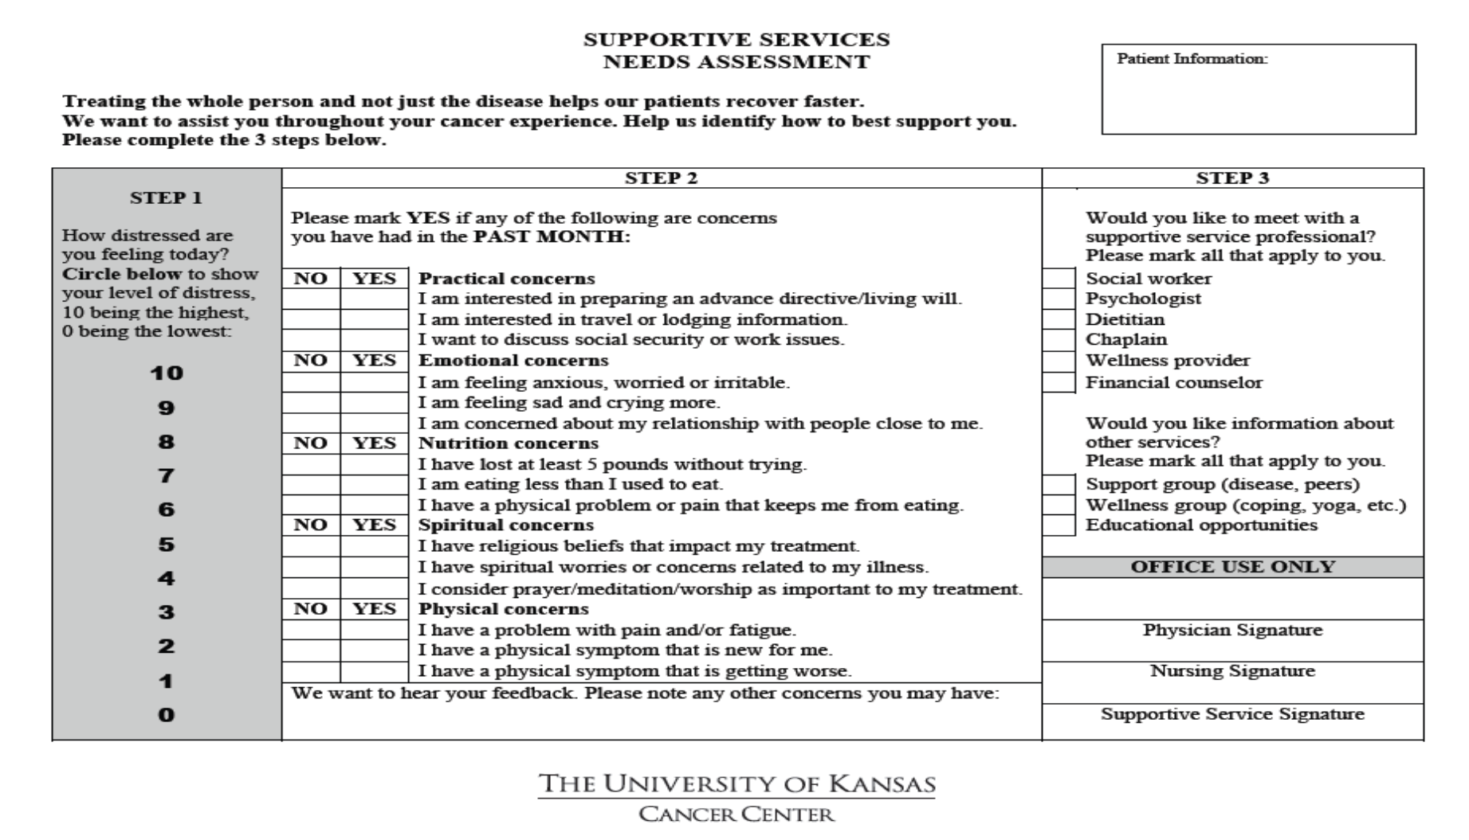

Slide 20
Let’s take a poll!
Which of the following needs seem the most frequent or most urgent among new patients in your practice or community?
                Practical
                Emotional
                Nutritional
                Spiritual
                Physical
Notes:
Based on the new patients you encounter, which domain seems to represent the most frequent or most urgent among patients in your practice or community?
Practical
Emotional
Nutritional
Spiritual
Physical

Slide 21
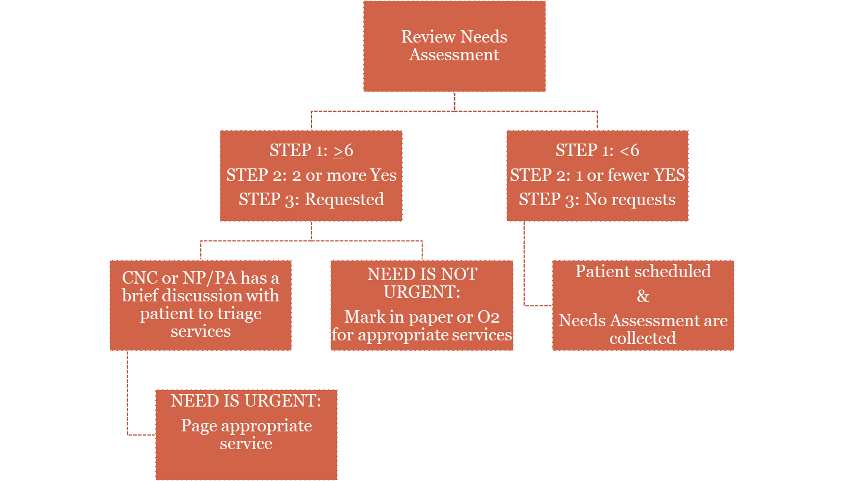
KU Needs Assessment Workflow

Slide 22
KU Experience – Unmet Needs
Unmet Need | 1 unmet need N(%) | 2 unmet needs N(%) | 3 unmet needs N(%)
Practical | 92 (12.9) | 32 (4.4) | 17 (2.4)
Emotional | 33 (4.6) | 160 (22.4) | 22 (3.1)
Nutritional | 141 (19.8) | 118 (16.6) | 70 (9.8)
Spiritual | 306 (42.9) | 24 (3.4) | 15 (2.1)
Physical | 99 (13.9) | 151 (21.2) | 88 (12.4)

Slide 23
KU Experience – Resultant Referrals
Appointments with Support Services 12 months following distress screening:
Support Service | # of Patients used service | Range of appointments
Psychology | 227 (31.8) | 1-7
Social Work | 359 (50.4) | 1-5
Financial Counselor | 515 (72.3) | 1-5
Dietician | 281 (39.4) | 1-7

Slide 24
Case Study: Checking In After a Needs Assessment
Both are men around 60 with intermediate risk, metastatic clear cell RCC, but below the surface they have diverging needs and interests.
Mr. A’s needs assessment revealed:
Desire to participate in a support group, wellness group, and educational opportunities
Mr. B’s needs assessment revealed:
Interested in discussion social security / work issues
Clinically significant nutritional issues
Uncontrolled pain
Asked to speak with a social worker

Slide 25
Kidney Cancer Specific Evaluation
In addition to assessment of patient psychosocial needs and nutrition via formal “needs assessment,” stage, symptoms, and comorbidities should be assessed in a standard fashion.
However, patients with kidney cancer require formal cancer risk stratification via the MSKCC¹ or IMDC² risk calculators.
Risk score determines appropriateness of FDA-approved systemic therapy options:
  MSKCC:
    One point for each: Interval from diagnosis to treatment < 1 year, KPS < 80%, LDH > 1.5 ULN, Ca > ULN, HgB < LLN
  IMDC
    One point for each: Interval from diagnosis to treatment < 1 year, KPS< 80%, HgB < LLN (< 12 g/dL), Ca > ULN (>10.2 mg/dL), ANC > ULN (> 7), platelets > ULN (> 400K)
  For both: favorable risk 0 points, intermediate risk 1-2 points, poor risk ≥ 3 points
¹ Motzer RJ, et al. (1999); ²Heng DYC, et al. (2009)
Notes:
1. Motzer RJ, Mazumdar M, Bacik J, Berg W, Amsterdam A, Ferrara J. Survival and prognostic stratification of 670 patients with advanced renal cell carcinoma. J Clin Oncol. 1999;17(8):2530-40. doi: 10.1200/JCO.1999.17.8.2530.
2. Heng DYC, Xie WL, Regan MM, Warren MA, Golshayan AR, Sahi C, et al. Prognostic Factors for Overall Survival in Patients With Metastatic Renal Cell Carcinoma Treated With Vascular Endothelial Growth Factor-Targeted Agents: Results From a Large, Multicenter Study. Journal of Clinical Oncology. 2009;27(34):5794-9. doi: 10.1200/Jco.2008.21.4809.

Slide 26

Factors in Decision-Making
IMDC (or MSKCC) risk stratification
Cytoreductive nephrectomy
  Nearly all favorable risk patients will be s/p cytoreductive nephrectomy.
  Poor risk patients generally recommended to avoid up-front cytoreductive nephrectomy. Delayed nephrectomy can be considered in the setting of robust response.
  More discussion coming soon in TOQQ-RCC session 2 . . .
Metastasis-directed therapy (MDT) versus systemic therapy
  MDT is most appropriate in fit patients with oligometastatic, favorable or intermediate-1 disease
  If patients have 1-2 lung metastases can consider nephrectomy + metastasectomy
  Typically, do not recommend for liver or bone metastases
  Otherwise, systemic therapy is recommended, while theoretically retaining “consolidative” metastasis-directed therapy in the future in the setting of excellent response

Slide 27

Factors in Decision-Making, cont.
 | Checkmate 214 (Ipi + Nivo)⁴ (n=550 vs n = 546) | KEYNOTE-426 (Axi + Pembro)⁵ (n= 432 vs n = 429) | CheckMate 9ER (Cabo + Nivo)⁶ (n = 323 vs n = 328) | CLEAR (Len + Pembro)⁷ (n = 355 vs n = 357)
mOS, months HR (CI) | NR vs 38.4 0.69 (0.59-0.81) | NR vs 35.7 0.68 (0.55-0.85) | NR vs NR 0.60 (0.40-0.89) | NR vs NR 0.66 (0.49-0.88)
Landmark OS 12 mo Landmark OS 24 mo | 83% vs 78% 71% vs 61% | 90% vs 79% 74% vs 66% | 87% vs. 78% (est.) 74% vs 60% (est) | 90% vs 79% (est) 79% vs 70%
mPFS, months HR (CI) | 12.2 vs 12.3 0.89 (0.76-1.05) | 15.4 vs 11.1 0.71 (0.60-0.84) | 16.6 vs 8.3 0.51 (0.41-0.64) | 23.9 vs 9.2 0.39 (0.32-0.49)
ORR, % | 39 vs. 32 | 60 vs 40 | 56 vs 27 | 71 vs 36
CR, % | 11 vs 3 | 9 vs 3 | 8 vs 5 | 16 vs 4
Med f/u, months | 55 | 30.6 | 18.1 | 27
Prognostic risk, % Favorable Intermedicate Poor | 23 61 17 | 32 55 13 | 23 58 19 | 31 59 9
Prior nephrectomy | 82% | 83% | 69% | 74%
Subsequent systemic therapies for Sunitinib arm, % | Overall 69% IO 42% | Overall 69% IO 48% | Overall 40% IO 29% | NR
Can’t | compare | toxicity | for | all
Symptoms: In highly symptomatic patients, prioritize therapies with highest overall response rate.
Available 1L therapies
Table adapted from Brian Rini and Uromigos podcast https://anchor.fm/the-Uromigos
¹ Motzer RJ, et al. (2018); ² Powles T, et al. (2020). ³ Choueiri TK, al. (2020). ⁴ Motzer R, et al. (2021)
Notes:
1 Motzer RJ, Tannir NM, McDermott DF, Aren Frontera O, Melichar B, Choueiri TK, et al. Nivolumab plus Ipilimumab versus Sunitinib in Advanced Renal-Cell Carcinoma. N Engl J Med. 2018;378(14):1277-90. doi: 10.1056/NEJMoa1712126.
2 Powles T, Plimack ER, Soulieres D, Waddell T, Stus V, Gafanov R, et al. Pembrolizumab plus axitinib versus sunitinib monotherapy as first-line treatment of advanced renal cell carcinoma (KEYNOTE-426): extended follow-up from a randomised, open-label, phase 3 trial. Lancet Oncol. 2020;21(12):1563-73. doi: 10.1016/S1470-2045(20)30436-8.
3 Choueiri TK, al. E. Nivolumab + cabozantinib vs sunitinib in first-line treatment for advanced renal cell carcinoma: First results from the randomized phase III CheckMate 9ER trial. European Society of Medical Oncology. Virtual2020.
4 Motzer R, Alekseev B, Rha SY, Porta C, Eto M, Powles T, et al. Lenvatinib plus Pembrolizumab or Everolimus for Advanced Renal Cell Carcinoma. N Engl J Med. 2021;384(14):1289-300. doi: 10.1056/NEJMoa2035716.

Slide 28
An Embarrassment of Riches
The higher ORR and CR rates are compelling and practice-changing, but how exactly should we change our practices?
Toxicity can’t yet be compared across trials and Lenvatinib + Pembrolizumab is concerning for high rates of toxicity given high rate of Lenvatinib dose-attenuations.
No one knows yet if higher ORR or CR rates or longer PFS will translate into longer OS for metastatic RCC, so how do we know if higher toxicity is “worth it?”

Slide 29

An Embarrassment of Riches, cont.
It’s tempting to choose a one-size-fits all treatment (e.g., Lenvatinib + Pembrolizumab given ORR and CR) but a personalized approach is the most patient-centered approach.
  Frailty and comorbidities
  Willingness and ability to come participate in symptom check visits
  Capacity to assess and communicate symptoms between visits
  Determinants (including social determinants) of adherence and persistence
  Goals of care

Slide 30

Let’s take a poll!
Even when we can identify the ideal treatment regimen for a patient, the cost of treatment, particularly for oral medications, can create barriers.
In your practice, have you encountered circumstances when patients were unable to take recommended treatments due to the cost of oral medications (for any cancer, not just kidney cancer)?
                Yes No
Have overcome some of these barriers?
Please share your strategies in the chat box!
Notes:
Other factors that can influence choice of treatment – cost of oral cancer medications
Even if we are able to identify the ideal treatment regimen for a patient, the cost of treatment, particularly for oral medications, can create barriers.
In your practice, have you encountered circumstances when patients were unable to take recommended treatments due to the cost of oral medications (for any cancer, not just kidney cancer)?
Yes
No
If you’ve been able to overcome some of these barriers, please share with us some of your strategies in the chat box.

Slide 31
Case Study: Making Some Decisions
Mr. A
IMDC intermediate-1
Minimally symptomatic
Motivated by QOL > aggressive longevity goal
Mr. B
IMDC intermediate-2
Significantly symptomatic
Motivated by longevity with aggressive goals > QOL

Slide 32
Case Study: Making Some Decisions, cont.
Mr. A
Treatment considerations
  Minimally symptomatic, and therefore isn’t in grave danger if he doesn’t get an immediate response
  PPE would be a highly likely symptom for a long-distance runner (as friction contributes significantly) and would be highly distressing symptom to him
Mr. B
Treatment considerations
  Highly symptomatic, needs pain relief and improvement in cancer-related fatigue
  May “lose his window” for treatment if he doesn’t get a response quickly
  No specific considerations about symptoms to avoid

Slide 33
Case Study: Making Some Decisions, cont.
Mr. A
1L treatment decisions
  Describe the spectrum of options, but would ultimately recommend Ipilimumab + Nivolumab to him
Mr. B
1L treatment decisions
  Describe the spectrum of options, but would strongly recommend Lenvatinib + Pembrolizumab (preferred) or Cabozantinib + Nivolumab to him
  Counsel him that we may need to apply for financial assistance regarding oral agent

Slide 34
Case Study: Making Some Decisions, cont.
Same disease, same histology, same stage, same gender, (~) same age, but different needs and goals = individualized treatments.

Slide 35

Discussion & Questions

Slide 36
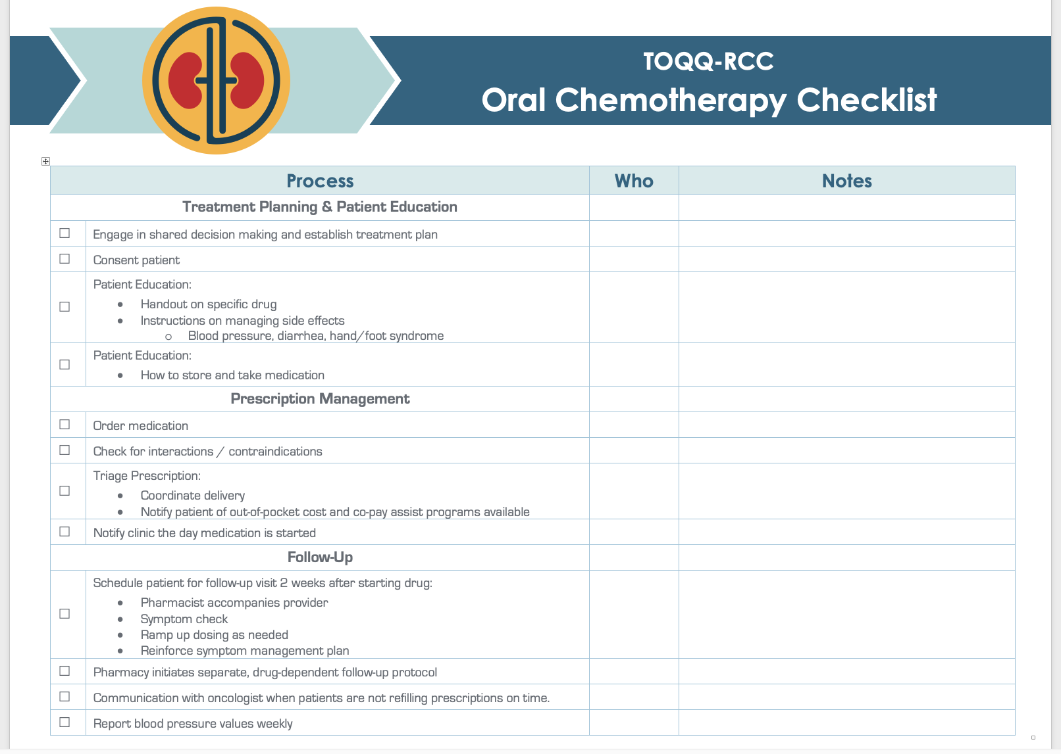

Send completed form to:
Catie
cknight2@kumc.edu

Slide 37
Announcements
Friday, May 14th @ Noon
Topic: Cytoreductive Nephrectomy in the CARMENA Era and Shared Decision-Making for Medical and Surgical RCC Treatment
Guest Speaker: Eugene Lee, MD
Notes:
shared decision-making for medical and surgical RCC treatment.
Eugene Lee, MD

Slide 38

Wrap-Up
Don’t forget to sign-in by putting your name in the chat box.
Activity Identification Code: 02hiss
Due Date: Thursday, April 22, 2021 at 5:00 PM
Text the activity identification code to (828) 216-8114 or www.eeds.com
You can review this presentation and materials in the Toolbox here:
http://www.masoniccanceralliance.org/cancer-survivorship-echo-series.html

