Slide 1




Using Tele-Mentoring to Optimize Quality of Care and Quality of Life for Patients With Metastatic Kidney Cancer (TOQQ-RCC) ECHO Series
Facilitators: Elizabeth Wulff-Burchfield, MD,
Jennifer Klemp, PhD, MPH & Catie Knight, MPH
Session 3 Topic: Immunotherapy Toxicity Monitoring, and Home Infusion
Guest Speaker: Gary C. Doolittle, MD

Slide 2
Agenda
Time | Presentation | Presenter
12:00– 12:10 pm | Welcome, Overview of Session, and Introductions | Catie Knight, MPH
12:10 – 12:30 pm | Case Presentation | Elizabeth Wulff-Burchfield, MD
12:30 – 12:55 pm | Didactic & Discussion: Immunotherapy Toxicity Monitoring, and Home Infusion | Gary Doolittle, MD Elizabeth Wulff-Burchfield, MD
12:55 – 1:00 pm | Wrap-up and Announcements | Catie Knight, MPH

Slide 3
It’s nice to meet you!
Please remember to sign-in by putting your name and email address in the Chat Box.
Notes:
Pause Share Screen and ask participants to introduce themselves.

Slide 4
Conflict of Interest Disclosure
The following presenters and/or planning committee members do not have any relevant financial relationships with any proprietary entities producing, marketing, re-selling, or distributing healthcare goods or services consumed by, or used on patients related to the content of their presentation: Gary Doolittle, MD; Catie Knight, MPH; Mary Beth Warren, MS, RN,
The following presenters and planning committee member has disclosed potentially relevant financial relationships with proprietary entities producing, marketing, re-selling or distributing healthcare goods or services consumed by, or used on, patients:
Elizabeth Wulff-Burchfield, MD received consulting fee from Astellas, Bristol Myers Squibb and Exelixis; owns stock in Immunomedics and Nektar
Jennifer Klemp, PhD, MPH received honoraria for consulting and speaking from Pfizer and honoraria for consulting from Astra Zeneca

Slide 5


You must sign in to Zoom with your full name (first and last) so we can confirm your attendance. After you sign in, if you discover you need to change your name to display your first and last name, click on the ‘Participants’ tab at the bottom of your screen where you see other meeting controls.
Continuing Education Statement
When the list of participants appears, hover your mouse over your name until you see the option to select ‘Rename’. Note—we will not be able to award continuing education credit or a certificate of attendance without your first and last name appearing on the Zoom attendance log.

Slide 6
Continuing Education Statement
Continuing education credit statements for TOQQ 6.11.21
Physicians: The University of Kansas Medical Center Office of Continuing Medical Education is accredited by the Accreditation Council for Continuing Medical Education (ACCME) to provide continuing medical education for physicians.
The University of Kansas Medical Center Office of Continuing Medical Education designates this live activity for a maximum of 1.0 AMA PRA Category 1 Credit(s)™. Physicians should claim only the credit commensurate with the extent of their participation in the activity.
APRN/RN: The University of Kansas Medical Center Area Health Education Center East is approved as a provider of CNE by the Kansas State Board of Nursing. This course offering is approved for 1.0 contact hours applicable for APRN or RN relicensure. Kansas State Board of Nursing provider number: LT0056-0749. Mary Beth Warren, MS, RN, Coordinator.
Social Work: The University of Kansas Medical Center Area Health Education Center East, as an approved provider of continuing education by the Kansas Behavioral Sciences Regulatory Board presents this offering for a maximum of 1.0 hour credit applicable for relicensure of LASWs, LBSWs, LMSWs and LSCSWs. Kansas Provider Number 12-002. Mary Beth Warren, MS, RN, coordinator.
Attendance requirement for nurses and social workers: Participants missing more than 10% of this offering will not receive continuing education credit. Partial credit will not be awarded.
Certificates of attendance are available to other participants upon completion of documentation of attendance and evaluation

Slide 7
Continuing Education Credit or Certificate of Attendance
ACTIVITY IDENTIFICATION/SIGN IN CODE: 93sorn
DEADLINE TO ENTER CODE AND COMPLETE EVALUATION: Thursday, June 17, 2021 at 5:00 PM
Using your mobile phone, you can text the activity identification code to (828) 216-8114.
OR
Accessing www.eeds.com from a mobile device or PC and entering the activity identification code;
OR
Downloading the eeds mobile app (iOS, Android) and using the activity identification code to sign-in to events.

Slide 8
Funding Source
This project is funded by a Pfizer Independent Grant for Learning and Change with additional support from The University of Kansas Cancer Center and Masonic Cancer Alliance.

Slide 9

Recording
This ECHO session will be recorded for educational and quality improvement purposes.
By participating in this ECHO clinic, you are consenting to be recorded.

Slide 10




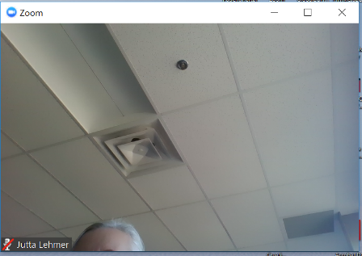
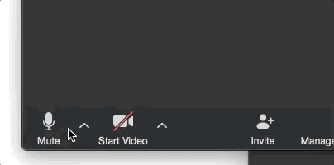


4
ECHO Clinic Tips
CAMERAS ON
Well-lit faces are
more engaging!
TESTING 1, 2, 3
Test both audio &
video in advance.
PARTICIPATE
Speak clearly, use the chat box, and actively engage.
MUTE YOURSELF
when you’re not speaking.

Slide 11

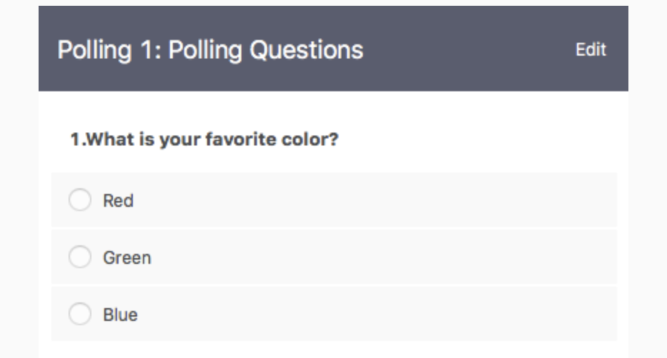
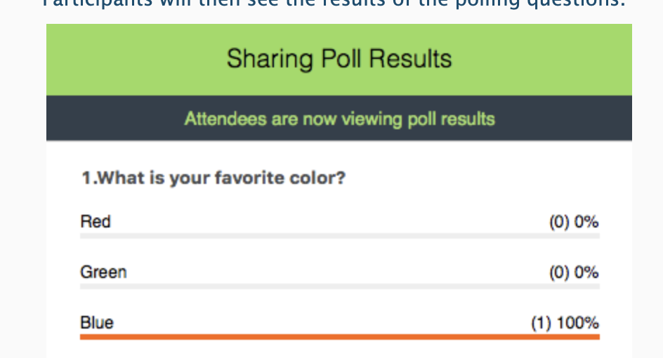

Polling Questions
Answer the poll question
See real-time results

Slide 12


Case Presentations & Patient Privacy
Goal: Protect patient privacy
Please only display or say information that does not identify a patient or that can not be linked to a patient.
Photos used in Case Study slides are freely-usable images from www.unsplash.com and not actual photos of known patients.
www.hipaa.com

Slide 13
Session 3 Learning Objective
Characterize the spectrum of immunotherapy toxicity and describe best practices for toxicity monitoring across the continuum of care.

Slide 14


Case Study: “Mrs. T”
46-year-old patient, “Mrs. T”
Demographics
  Born genetically female, self identifies as female with she/her pronouns
  Licensed social worker, has family therapy private practice
Comorbidities
  Uterine fibroids and iron deficiency anemia
Diagnosis History
  Longstanding history of menorrhagia d/t uterine fibroids and discovered a change to her pattern of bleeding. Specifically, she began to note intermittent, painless gross hematuria.
  Transvaginal ultrasound revealed thin endometrial stripe, abdominal ultrasound performed for further evaluation revealed a large right lower kidney pole mass.
  Undergoes radical nephrectomy revealing stage III, grade III clear cell renal cell carcinoma and begins surveillance.
  18-months postoperative imaging reveals 10-20 small pulmonary nodules. Biopsy reveals metastatic clear cell renal cell carcinoma.
  One abnormal lab at the time of diagnosis reveals anemia with hemoglobin 8.4 g/dL.
Goals
  “I want to get this taken care of.”

Slide 15

Case Study
Patient presents to establish medical oncology care
IMDC (International Metastatic RCC Database Consortium) risk categorization: Intermediate-1 (based on anemia)
Medical decision-making results in the decision to pursue first line Nivolumab + Ipilimumab.
Ms. T asks, “What are immunotherapy side effects like? I want to know how I’m going to feel on this treatment and what to look out for.”
How do you counsel Ms. T about her experience?
This case study could easily feature any malignancy managed with ICI therapy.
Notes:
How do you prepare her and set appropriate expectations?

Slide 16

The Immunotherapy Spectrum
Immunotherapy includes a broad range of therapies:
  Checkpoint inhibitors
  Cytokines
  Vaccines
  CAR T-cell Therapy
Notes:
Most of this talk will focus on immune checkpoint inhibitors

Slide 17

Immune Checkpoint Inhibitors (ICIs)
Immune checkpoints are molecules that help maintain immune balance by facilitating the immune system’s recognition of “self,” thereby preventing autoimmunity.
Checkpoints include co-inhibitory molecules (e.g., CTLA-4, PD-1) and co-stimulatory molecules (e.g., OX-40).¹
Tumor cells can evade innate immune surveillance by expressing co-inhibitory molecules on cancer cell surfaces.²
Immune checkpoint inhibitor (ICI) therapies are monoclonal antibodies blocking co-inhibitory molecules, thus “unleashing” cell-mediated immunity to help control cancer.¹
All ICIs have the potential to create an unchecked immune environment, inducing inflammatory/autoimmune side effects (immune-related adverse events [irAEs]).¹
While clinical trials demonstrate patterns to irAEs, these effects are unpredictable on the individual patient level. There is no “universal” experience.
1. Haanen JB, Thienen H, Blank CU. Toxicity patterns with immunomodulating antibodies and their combinations. Semin Oncol 2015; 42: 423–428.
2. Pardoll DM. The blockade of immune checkpoints in cancer immunotherapy. Nat Rev Cancer 2012; 12: 252–264
Notes:
References: 1Haanen JB, Thienen H, Blank CU. Toxicity patterns with immunomodulating antibodies and their combinations. Semin Oncol 2015; 42: 423–428.
2Pardoll DM. The blockade of immune checkpoints in cancer immunotherapy. Nat Rev Cancer 2012; 12: 252–264

Slide 18
Incidence and Nature of irAEs
Incidence of all types/grades of irAEs ranges from 39-96% (most often 70-100%) depending on agent, dose, setting, patient population.¹
  Incidence of grade 3-4 irAEs ranges from 0-61% (most often 20-55%) depending on same factors
Most common irAEs: fatigue, pruritis, rash, diarrhea, hypothyroidism¹
  Most common grade 3/4 irAEs: fatigue, diarrhea, rash, hypophysitis, pneumonitis, hepatitis
1. Haanen JB, Thienen H, Blank CU. Toxicity patterns with immunomodulating antibodies and their combinations. Semin Oncol 2015; 42: 423–428.

Slide 19
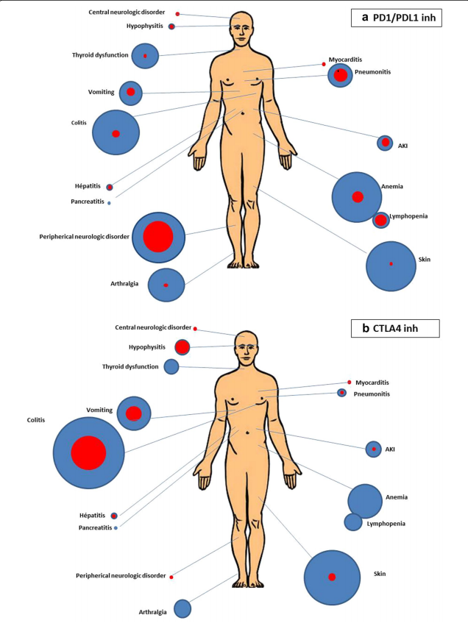
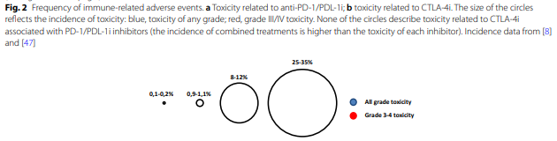
Incidence and Nature of irAEs, cont.
3. Lemiale V et al. Severe toxicity from checkpoint protein inhibitors: What intensive care physicians need to know? Ann Intensive Care. (2019)9:25.

Slide 20
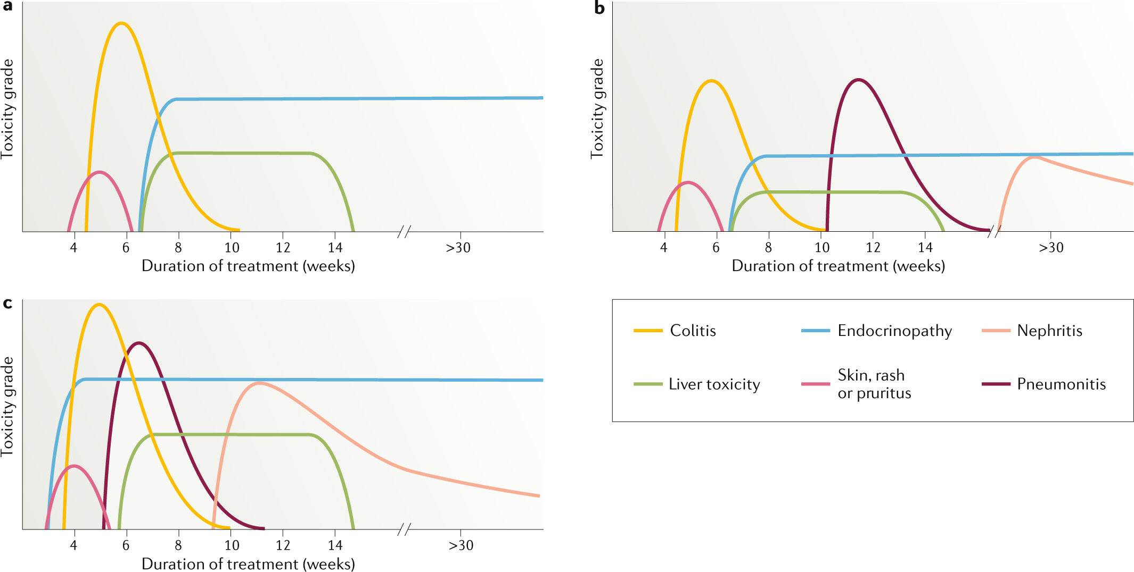
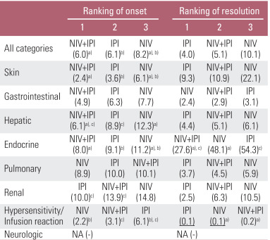
irAE Timing
Majority of grade 3-4 adverse events occur within 8-12 weeks of initiation
  Endocrinopathies, pneumonitis, and nephritis tend to develop later
irAEs develop earlier in combined PD-1/CTLA4 combinations
Time to resolution depends on presenting grade and treatment regimen, but is often < 1 month (table)
PD-1 inhibitors
PD-L1 inhibitors
PD-1 + CTLA-4 combination
4. Tang S, et al. The pattern and time to onset and resolution of immune-related adverse events caused by immune checkpoint inhibitors in cancer: a pooled analysis of 23 clinical trials and 8,347 patients. Cancer Res Treat. 2021 Apr;53(2):339-354

Slide 21
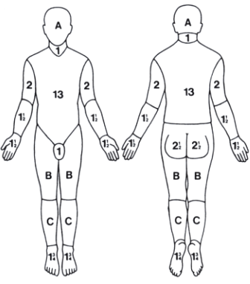
Case Study
Ms. T receives cycles 1 and 2 of Nivolumab + Ipilimumab without incident
After cycle 3, she notifies the office of a widespread and pruritic rash
Presents for urgent evaluation, revealing maculopapular eruption on entire trunk and back (= 26% of body surface area = CTCAE 5.0 grade 2)
Per NCCN guidelines, topical and high-potency steroids prescribed but symptoms are unresponsive, therefore, patient is treated with Prednisone 0.5 mg/kg/day with taper over 4 weeks
Decision is made to resume Nivolumab alone

Slide 22

irAE Management
Each individual irAE has grade-based management paradigms outlined by the Society for Immunotherapy for Cancer (SITC), the American Society of Clinical Oncology (ASCO), and the National Comprehensive Cancer Center Network (NCCN).
Familiarize yourself with one of these guidelines and keep it handy!
The common theme to all guidelines is that early recognition is key.
SITC: www.sitcancer.org
ASCO: www.asco.org
NCCN: www.nccn.org

Slide 23
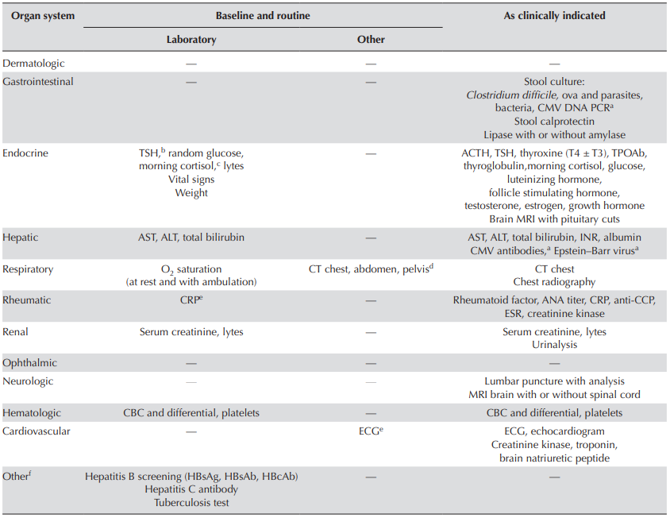
irAE Monitoring
Given that recognition is the key to management, monitoring is essential.
Aforementioned societies provide guidelines for laboratory monitoring (table).
Clinical monitoring is recommended prior to every cycle.
But what about symptoms that arise between cycles?
5. Myers G. Immune-related adverse events of immune checkpoint inhibitors: a brief review. Curr Oncol. 2018 Oct;25(5):342-347

Slide 24

Patient Counseling
While data supports the use of electronic patient-reported outcome monitoring to improve symptom control and treatment fidelity in advanced cancer,⁶ this is not widely available or acceptable to all patients.
Therefore, patient self-assessment and reporting is the backbone of irAE surveillance between visits.
No evidence-based strategy for patient education and counseling regarding checkpoint inhibitor therapy.
Unfortunately, data indicates that pre-chemotherapy treatment counseling is often ineffective and that educational needs are often unmet.⁷
6. Basch E et al. Overall survival results of a trial assessing patient-reported outcomes for symptom monitoring during routine cancer treatment. JAMA 2017;318:197-8.
7. Papadakos CT, et al. From theory to pamphlet: the 3Ws and an H process for the development of meaningful patient education resources. J Cancer Educ 2014;29:304–10

Slide 25

Patient Counseling Best Practices
Have a patient support person or caregiver present
Provide multiple methods of content delivery
  Verbal instruction in person
  Written materials
  Consider robust multimedia options with videos, including web pages and/or social media resources
Provide reassurance to patients and caregivers that reporting symptoms will not necessarily result in any changes to immunotherapy or cancer treatment protocols
8. Naing A, et al. Strategies for improving the management of immune-related adverse events. Journal for ImmunoTherapy of Cancer 2020;8:e001754. doi: 10.1136/jitc-2020-001754

Slide 26

Specific Communication Paradigms to Consider
“ER approach”
Describe the most common side effects that are observed and the most serious side effects that are possible.
“Best Case / Worst Case”⁸
Best case
“You don’t have any side effects or symptoms from the treatment.”
Most likely scenario
“You have one or two mild-to-medium side effects that need management and may or may not go all the way away. You could need a procedure to help diagnose or manage the issue, but it doesn’t require treatment to be permanently stopped.”
Worst case
“You have a severe side effect soon after starting the treatment, which may need hospitalization. You could need ICU care or even die from the side effect, but this is extremely rare. The treatment is stopped permanently.”
9. Schwarze ML, Kehler JM, and Campbell TC. Nativating high risk procedures with more than just a street map. J Pall Med. 16:10. 2013

Slide 27
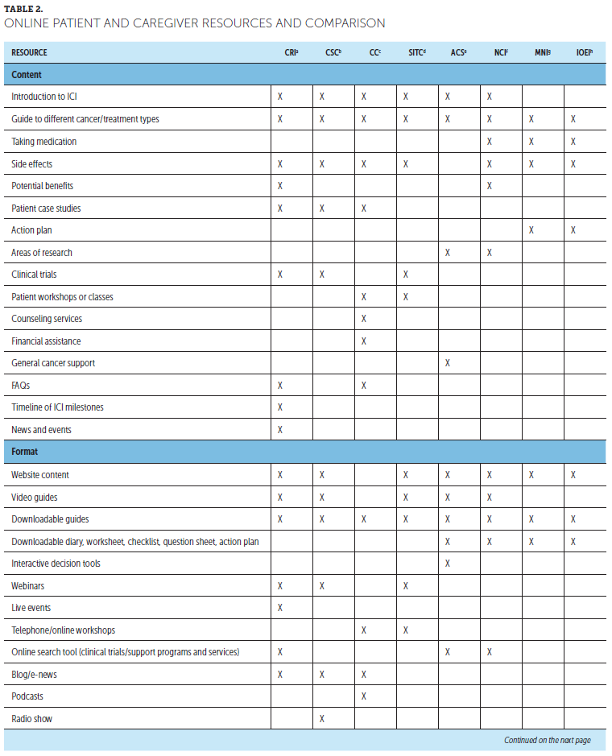
Patient and Caregiver Resources
Different societies and organizations offer different resources.
Some pharmaceutical companies also offer patient wallet cards or illustrated guides.
10. Wood LS, Moldawer NP, Lewis C. Immune checkpoint inhibitor therapy: key principles when educating patients. CJON 2019, 23(3), 271-280

Slide 28


A question for you…
What resources do you provide to patients and/or their caregivers about immunotherapy side effects reporting?
Tell us in the chat box!
Notes:
Other factors that can influence choice of treatment – cost of oral cancer medications
Even if we are able to identify the ideal treatment regimen for a patient, the cost of treatment, particularly for oral medications, can create barriers.
In your practice, have you encountered circumstances when patients were unable to take recommended treatments due to the cost of oral medications (for any cancer, not just kidney cancer)?
Yes
No
If you’ve been able to overcome some of these barriers, please share with us some of your strategies in the chat box.

Slide 29

Case Study
Ms. T continues on Nivolumab without recurrence of dermatitis. Ultimately developed hypothyroidism after cycle 10 of treatment but achieved euthyroid state with Levothyroxine supplementation.
Your office receives communication that her insurance payer is implementing home infusion for ICI therapy if stable for > 6 months, and Ms. T must change to home infusion.
How does your team navigate this transition and maintain safety?

Slide 30

Why Home Infusion?
Payer policies are resulting in an increase in site-of-care denials for ICI therapy.
  Mandating the patients receive treatment at a non-hospital-based infusion department.
  ICI therapies are not the only agents involved. Others include Pegfilgrastim, IVIG, Denosumab
For ICI therapy this is typically occurring for patients ≥ 6 months of systemic treatment.
Goals of home infusion therapy:
  Patient safety
  Transparency to the medical team
      Insurance Approval
      Scheduling
      Tolerability
      Patient tracking of immunotherapy/supportive care cycles
KU began a pilot of at-home immunotherapy administration in November 2020.

Slide 31
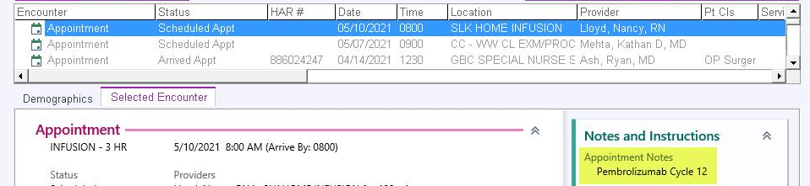
KU ICI Therapy Home Infusion Workflow
Patient lab and physician/provider visit conducted before each treatment cycle
  Utilize the existing EMR to schedule HI patients
  Current practice is 3-day interval between physician/provider visit and home infusion visit to allow home infusion company time to get drug to the patient

Slide 32
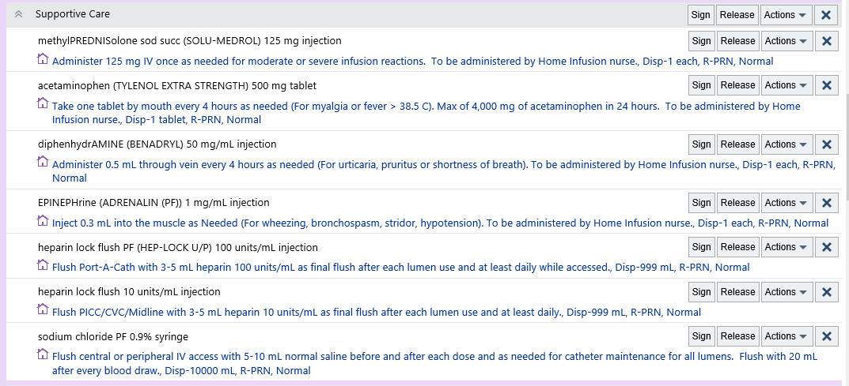
KU ICI Therapy Home Infusion Workflow, cont.
KUMC has implemented sending prescriptions to our home infusion team with everything the patient may need at home.
Anaphylaxis kit and flush kit sent to home to be available if needed for the HI nurse.

Slide 33
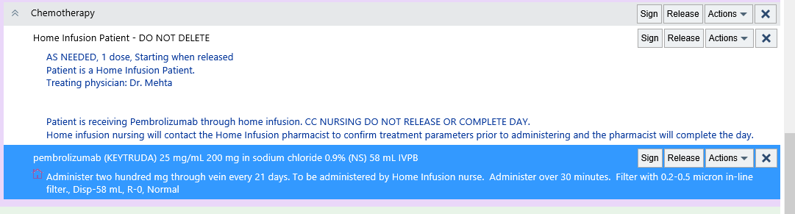
KU ICI Therapy Home Infusion Workflow, cont.
Home Infusion – Signing and Releasing Prescriptions
Once a patient is seen in clinic, and the next cycle of home infusion medication is approved and okay to treat, the team sends the prescription to home infusion queue.
Cancer center pharmacist double checks treatment parameters and ensures the patient schedule is correct, then releases prescription to home infusion company.
This is the signal to home infusion company that the patient is cleared for administration.

Slide 34

KU Home Infusion Experience
It works…
Home infusion is going to become the norm…
I can remember
  When nurses were not chemo/ immunotherapy certified…
  When we thought IV antibiotics administered in the home by a family member was dangerous
  Moving cancer treatment to the outpatient setting was driven by the payors…and dangerous…
This can be done safely…if we thoughtfully build the service…

Slide 35
Let’s Take a Poll!
Have you, or has your practice, managed patients with home administration of immune checkpoint inhibitor therapy?
Yes
No
Share your experiences, tips, tricks, and pearls in the chat box.

Slide 36

Discussion & Questions

Slide 37

Announcements
Join us for the next ECHO session on Friday, July 16th @ Noon
Tyrosine Kinase Inhibitor (TKI) Toxicity Monitoring and Management
Guest Speaker: Grace Martin, PharmD
Volunteers Needed for Qualitative Interview
Maryellen Potts, PhD is conducting a sub-study for TOQQ-RCC to explore clinician perspectives of provider-to patient education regarding ICI therapy and toxicity. Interviews take about 15-20 minutes and compensation for your time is provided.
Email Catie Knight at cknight2@kumc.edu for more information.
Notes:
Sub-study participant compensation = $50 Amazon gift card.

Slide 38

Wrap-Up
Don’t forget to sign-in by putting your name in the chat box.
Activity Identification Code: 93sorn
Due Date: Thursday, June 17, 2021 at 5:00 PM
Text the activity identification code to (828) 216-8114 or www.eeds.com
A recording of the previous session didactics and toolbox items are now available on the MCA website on the Telementoring page. www.masoniccanceralliance.org

