Slide 1




Using Tele-Mentoring to Optimize Quality of Care and Quality of Life for Patients With Metastatic Kidney Cancer (TOQQ-RCC) ECHO Series
Facilitators: Elizabeth Wulff-Burchfield, MD,
Jennifer Klemp, PhD, MPH & Catie Knight, MPH
Session 5 Topic: Toxicity education, monitoring, and management regarding combination immunotherapy or TKI-immunotherapy regimens for RCC
Guest Speaker: Jennifer Heins, PA-C

Slide 2
Agenda
Time | Presentation | Presenter
12:00– 12:10 pm | Welcome, Overview of Session, and Introductions | Catie Knight, MPH
12:10 – 12:30 pm | Case Presentation | Elizabeth Wulff-Burchfield, MD
12:30 – 12:55 pm | Didactic & Discussion: TKI Toxicity, Education, Monitoring and Management | Jennifer Heins, PA-C Elizabeth Wulff-Burchfield, MD
12:55 – 1:00 pm | Wrap-up and Announcements | Catie Knight, MPH

Slide 3
Conflict of Interest Disclosure
Conflict of interest disclosures:
The following presenters and/or planning committee members do not have any relevant financial relationships with any proprietary entities producing, marketing, re-selling, or distributing healthcare goods or services consumed by, or used on patients related to the content of their presentation: Jennifer Heins, PA; Catie Knight, MPH; Mary Beth Warren, MS, RN
The following presenters and planning committee member has disclosed potentially relevant financial relationships with proprietary entities producing, marketing, re-selling or distributing healthcare goods or services consumed by, or used on, patients:
Elizabeth Wulff-Burchfield, MD received consulting fee from Astellas, Bristol Myers Squibb and Exelixis; owns stock in Immunomedics and Nektar
Jennifer Klemp, PhD, MPH received honoraria from Novartis, Pfizer Oncology and Astra Zeneca
Potential conflicts have been mitigated

Slide 4


You must sign in to Zoom with your full name (first and last) so we can confirm your attendance. After you sign in, if you discover you need to change your name to display your first and last name, click on the ‘Participants’ tab at the bottom of your screen where you see other meeting controls.
Continuing Education Statement
When the list of participants appears, hover your mouse over your name until you see the option to select ‘Rename’. Note—we will not be able to award continuing education credit or a certificate of attendance without your first and last name appearing on the Zoom attendance log.

Slide 5
Continuing Education Statement
Continuing education credit statements for TOQQ 8.13.21
Physicians: The University of Kansas Medical Center Office of Continuing Medical Education is accredited by the Accreditation Council for Continuing Medical Education (ACCME) to provide continuing medical education for physicians.
The University of Kansas Medical Center Office of Continuing Medical Education designates this live activity for a maximum of 1.0 AMA PRA Category 1 Credit(s)™. Physicians should claim only the credit commensurate with the extent of their participation in the activity.
APRN/RN: The University of Kansas Medical Center Area Health Education Center East is approved as a provider of CNE by the Kansas State Board of Nursing. This course offering is approved for 1.0 contact hours applicable for APRN, or RN relicensure. Kansas State Board of Nursing provider number: LT0056-0749. Mary Beth Warren, MS, RN, Coordinator.
Social Work: The University of Kansas Medical Center Area Health Education Center East, as an approved provider of continuing education by the Kansas Behavioral Sciences Regulatory Board presents this offering for a maximum of 1.0 hour credit applicable for relicensure of LASWs, LBSWs, LMSWs and LSCSWs. Kansas Provider Number 12-002. Mary Beth Warren, MS, RN, coordinator.
Attendance requirement for nurses and social workers Participants missing more than 10% of this offering will not receive continuing education credit
Certificates of attendance are available to other participants upon completion of documentation of attendance and evaluation

Slide 6
Continuing Education Credit or Certificate of Attendance
ACTIVITY IDENTIFICATION/SIGN IN CODE: 27torn
DEADLINE TO ENTER CODE AND COMPLETE EVALUATION: Thursday, August 19, 2021 at 5:00 PM
Using your mobile phone, you can text the activity identification code to (828) 216-8114.
OR
Accessing www.eeds.com from a mobile device or PC and entering the activity identification code;
OR
Downloading the eeds mobile app (iOS, Android) and using the activity identification code to sign-in to events.

Slide 7
Funding Source
This project is funded by a Pfizer Independent Grant for Learning and Change with additional support from The University of Kansas Cancer Center and Masonic Cancer Alliance.

Slide 8

Recording
This ECHO session will be recorded for educational and quality improvement purposes.
By participating in this ECHO clinic, you are consenting to be recorded.

Slide 9




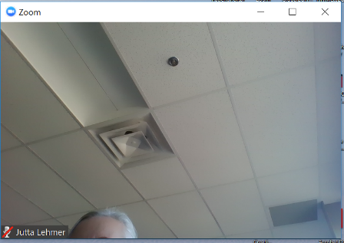
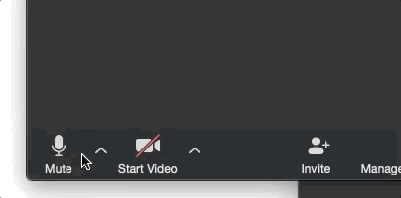


4
ECHO Clinic Tips
CAMERAS ON
Well-lit faces are
more engaging!
TESTING 1, 2, 3
Test both audio &
video in advance.
PARTICIPATE
Speak clearly, use the chat box, and actively engage.
MUTE YOURSELF
when you’re not speaking.

Slide 10

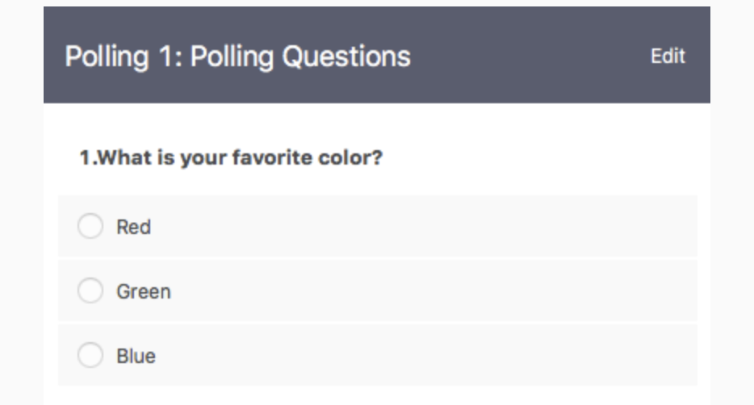
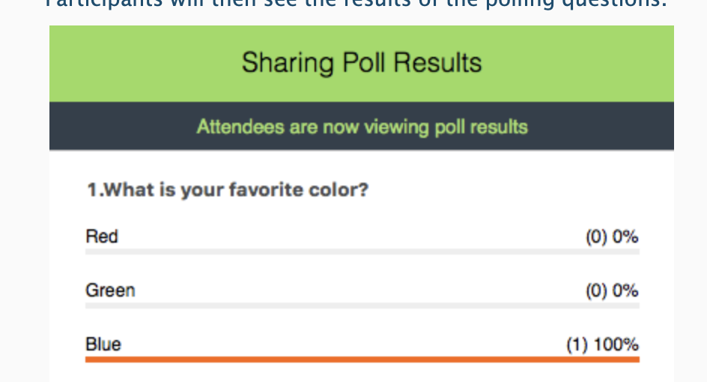

Polling Questions
Answer the poll question
See real-time results

Slide 11
It’s nice to meet you!
Please remember to sign-in by putting your name and email address in the Chat Box.
Notes:
Pause Share Screen and ask participants to introduce themselves.

Slide 12
Session 3 Learning Objective
Delineate roles among the oncology care team regarding comprehensive patient education and management.

Slide 13


Case Presentations & Patient Privacy
Goal: Protect patient privacy
Please only display or say information that does not identify a patient or that can not be linked to a patient.
Photos used in Case Study slides are freely-usable images from www.unsplash.com and not actual photos of known patients.
www.hipaa.com

Slide 14

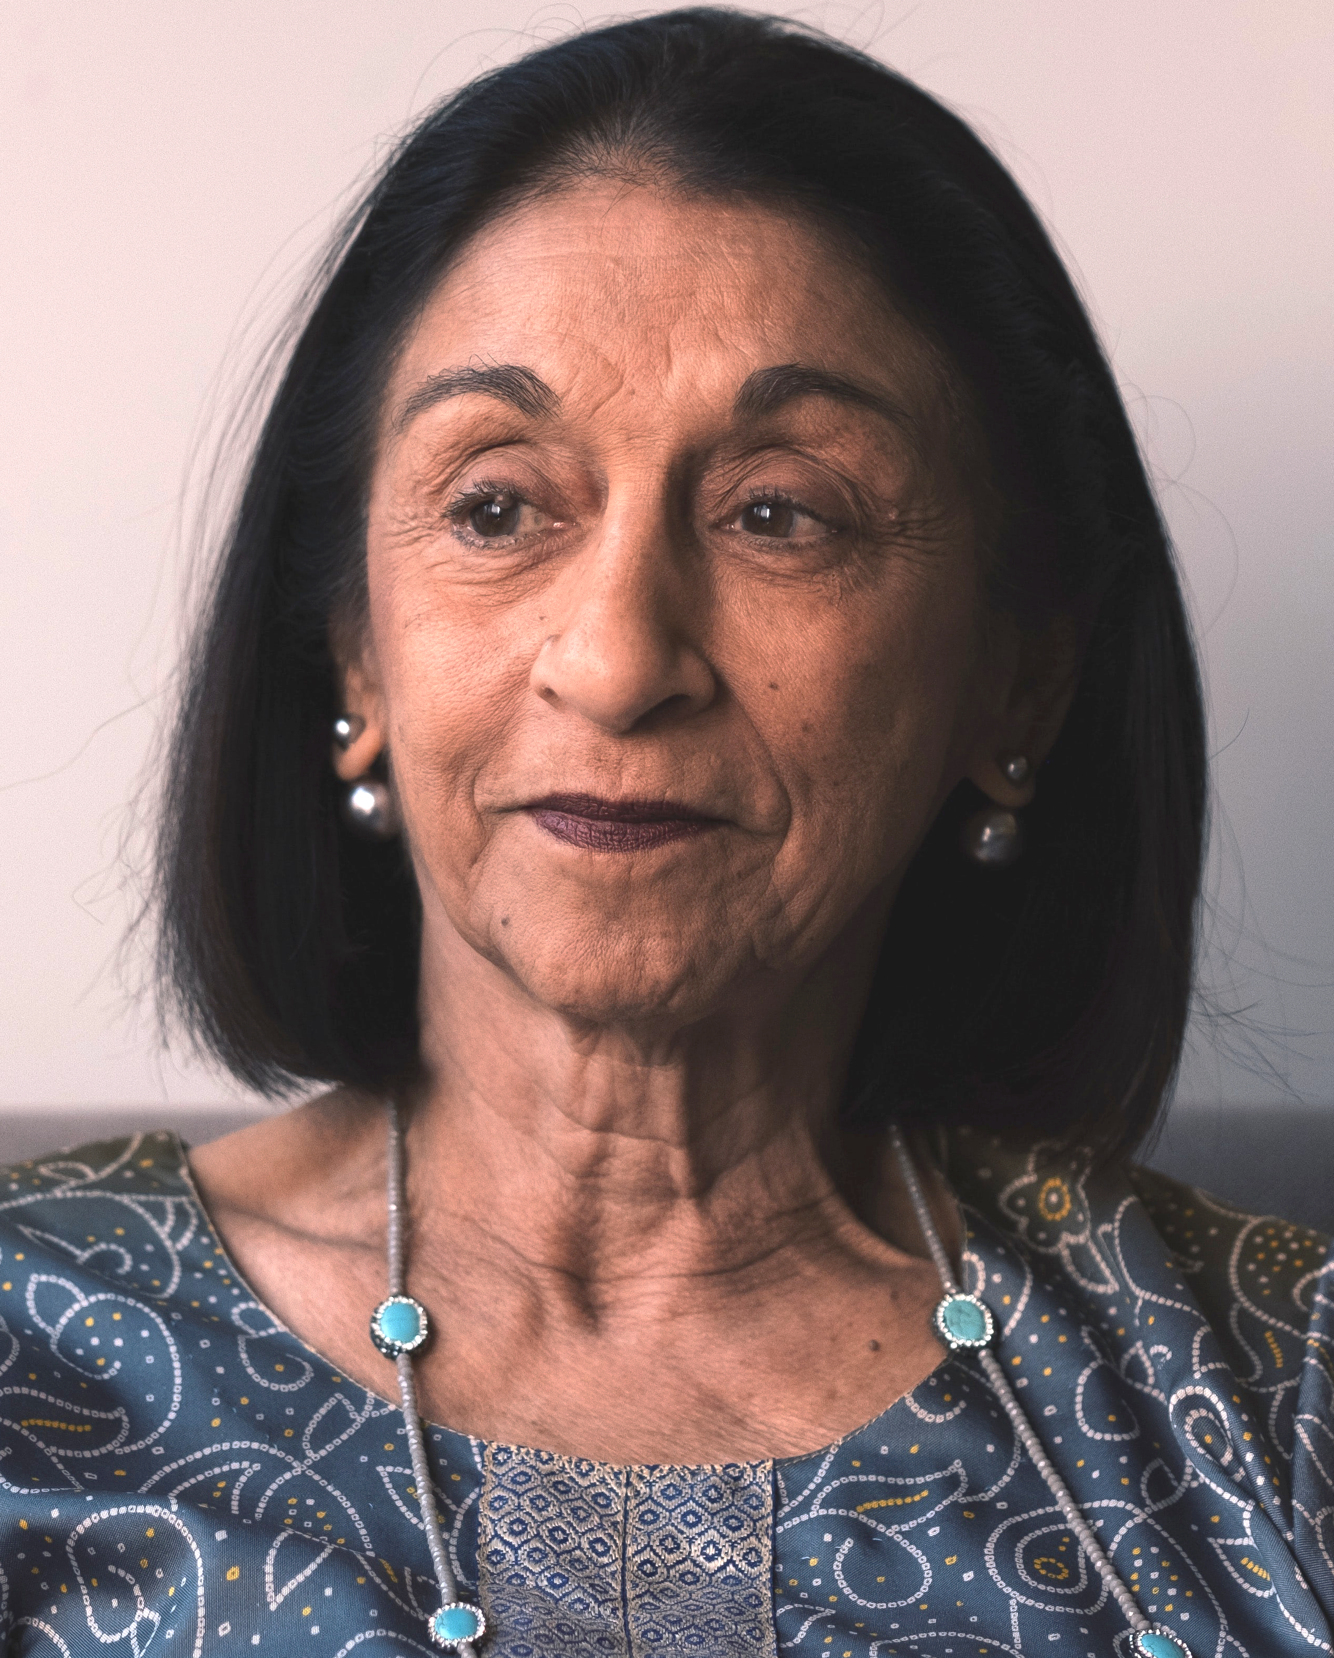
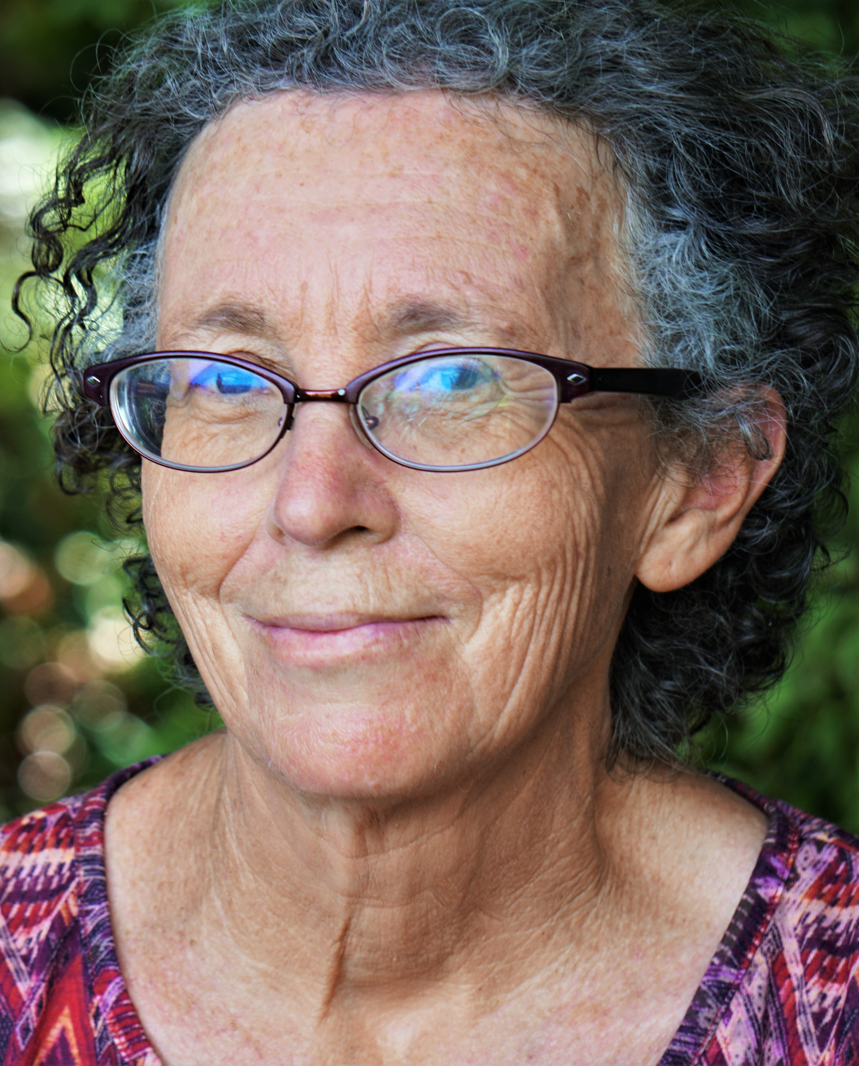
Case Study: A Tale of Two Kidneys
“Ms. Y”
74-year-old patient
Demographics
  Born as genetically female, self identifies as female with she/her pronouns
  Retired church secretary, enjoys gardening
  Divorced, has 3 adult children nearby
Comorbidities
  Migraine headaches, uterine fibroids s/p hysterectomy, osteoarthritis in R knee
“Ms. Z”
72-year-old patient
Demographics
  Born as genetically female, self identifies as female with she/her pronouns
  Retired school nurse, volunteers at animal shelter
  Widowed and remarried, no children
Comorbidities
  Allergic rhinitis, carpal tunnel syndrome s/p release surgery, obesity

Slide 15
Case Study, cont.
“Ms. Y”
Diagnosis History
  Developed left flank pain that worsened over 6-7 months and ultimately began to limit her ability to work in her garden
  CT T/L spine revealed L kidney mass, further staging negative for metastatic disease. Underwent L radical nephrectomy revealing pT3Nx (renal vein involvement), grade 2 clear cell renal cell carcinoma.
  18 months later CXR revealed multiple lung nodules. No other sites of disease, all labs normal.
  IMDC risk score – favorable
  Medical oncology visit leads to plans to start treatment with Axitinib + Pembrolizumab (one VEGFR-targeted TKI and one immunotherapy agent)
Goals
  Aggressive care
”Ms. Z”
Diagnosis History
  Acutely developed painless gross hematuria, sought care in ER.
  CT a/p “stone protocol” revealed L kidney mass with tumor thrombus extending to vena cava, multiple enlarged RP lymph nodes, 3-4 lung nodules in each lung, measuring 0.5-2 cm
  Biopsy of lung nodule clear cell RCC
  IMDC risk score – intermediate
  Medical oncology visit leads to plans for Nivolumab + Ipilimumab (two immunotherapy agents)
Goals
  Aggressive care

Slide 16

How do we get off on the right foot?
What are the best ways to counsel Ms. Y and Ms. Z about their combination treatments?

Slide 17

Let’s Take a Poll!
What is your biggest concern about challenges relating to combination treatments (other than treatment side effects)?
Patients or caregivers feeling more overwhelmed/intimidated by multiple treatments
Uncertainty about how to attribute treatment side effects between the two agents
Adherence to two separate treatments
Higher patient cost
Other (Please add these to the Chat Box!)
Notes:
We will cover items 1 and 2 above in this talk – items 3 and 4 are covered in our last talk with Dr. Grace Martin, an oncology pharmacist. We recommend that you circle back if you weren’t able to join us live.

Slide 18

Patient Education - Principles
Informed consent
  Mandated/protected by law as part of modern medical bioethics
    Arose from the ethical principles of autonomy and self-determination (e.g., basic human rights”)
  Consent is easy, informing is hard
In addition to protecting patients, informed consent discussions promote safety by educating patients and support persons about treatment effects and side effects and setting expectations that facilitate coping.
Nature and content of these discussions will depend on the treatments involved, but many principles can apply to other cancers that use these treatments or more generally to treatment counseling.
Notes:
These discussions are hard to do well, and I would imagine that many of us have experienced a less-than-ideal discussion or witnessed its aftermath.
- There is a lot that depends on these conversations, and so few of us have formal training!
- Based on feedback from our qualitative study, advance practice providers are particularly adept at conducting these discussions

Slide 19
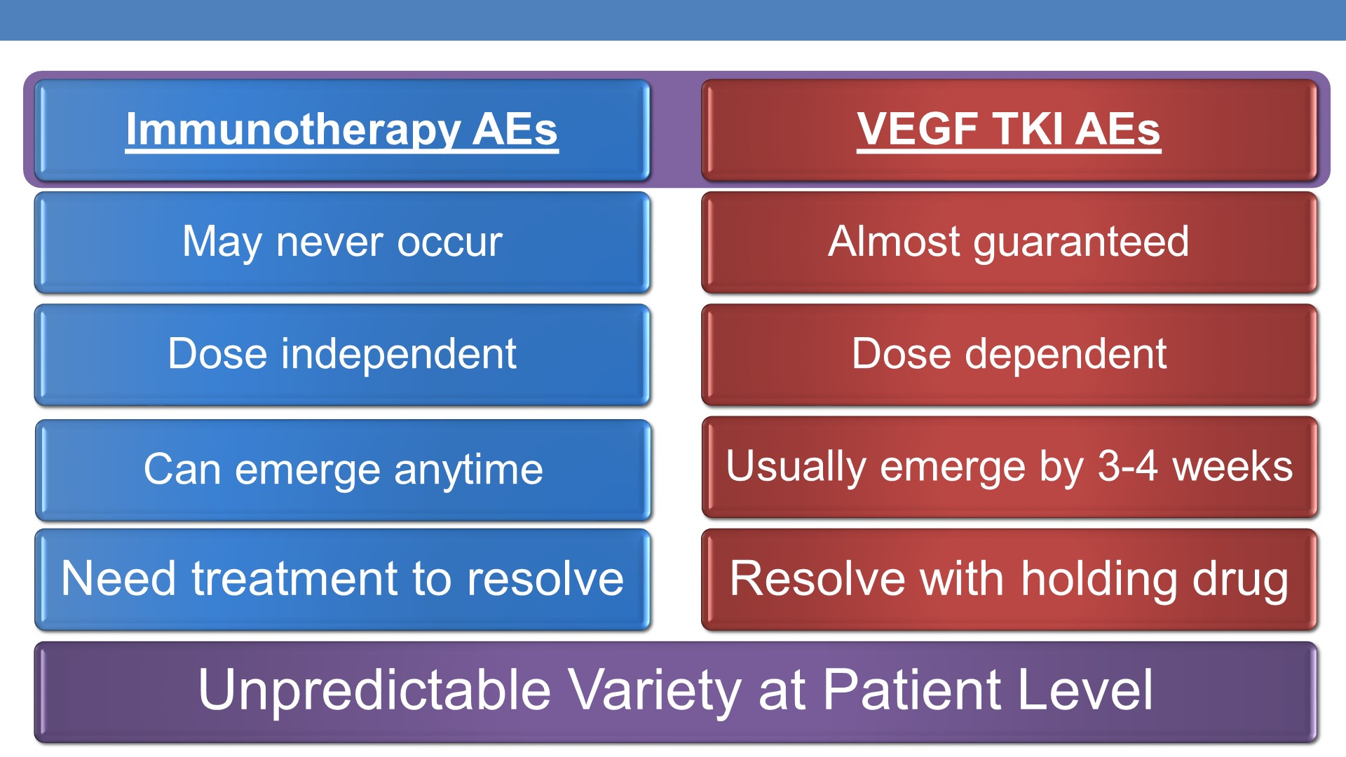

Patient Education – Principles, cont.
Plimack, E. Management of first-line treatment options for clear cell RCC. 2020 ASCO GU Symposium. San Francisco, CA.

Slide 20
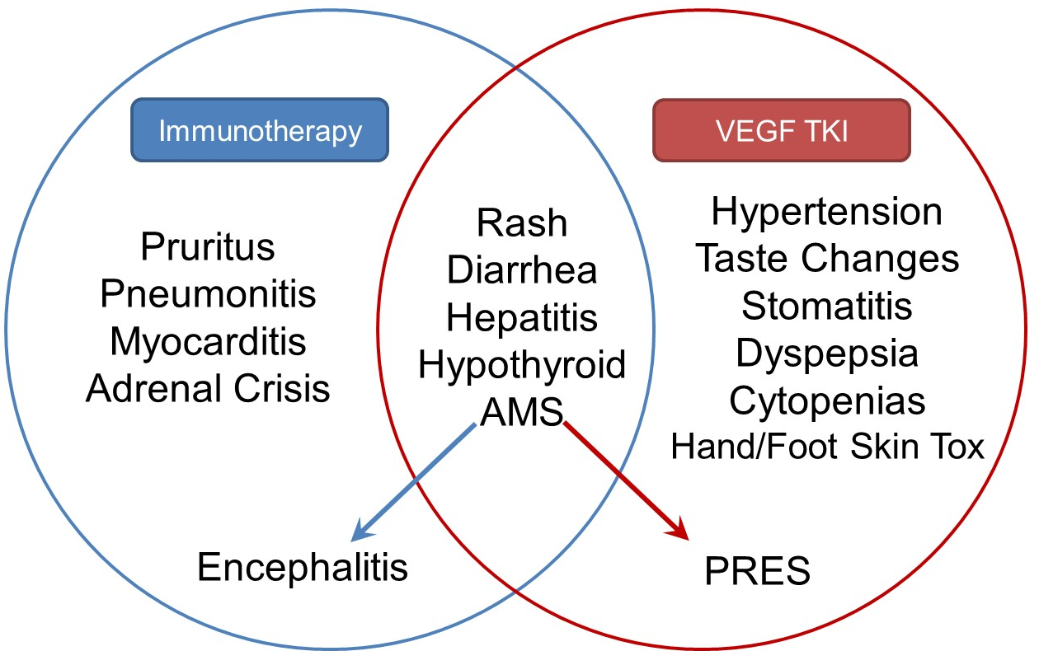
Patient Education – Principles, cont.
Plimack, E. Management of first-line treatment options for clear cell RCC. 2020 ASCO GU Symposium. San Francisco, CA.
Notes:
When TKI + IO combinations were initially rising in popularity, an early concern was with how adverse effect management

Slide 21
Patient Education
General Best Practices
There is no one right way to counsel patients about their treatments
  Individual needs will depend on many factors including, but not limited to patient literacy, hearing, vision, anxiety, coping, medical literacy, social support, and others.
Whenever possible, it is best to encourage participation of one or more support people (partners, friends, relatives) in the counseling visit.
In addition to discussion, try to provide patient-facing written materials.
  Our workflow typically involves the physician providing the patient written information about the treatments before the treatment counseling visit.

Slide 22
Patient Education – Pearls
“ER approach”
  Most common and most dangerous side effects, with an emphasis on symptoms
    When discussing possible side effects, this approach can help focus patients’ and caregivers’ attention, set the stage for prevention strategies, and facilitate coping
    For TKIs, would emphasize fatigue, diarrhea, hand-foot syndrome, hypertension
      When TKI is paired with immunotherapy, would especially emphasize diarrhea, skin changes
    For immunotherapy, would emphasize fatigue, rash, diarrhea, cough, dyspnea
      When patient is taking a combination of 2 immunotherapies, would especially emphasize diarrhea and fatigue
Notes:
Jennifer – on this slide, after you say your points of emphasis for TKIs and immunotherapy, I will ask you what you would say to a patient when counseling them about the highlights for Ms. Y (TKI + IO) versus Ms. Z

Slide 23
Patient Education – Pearls, cont.
Prevention is Key
  Not all side effects can be prevented, but those that can be, should be.
  As discussed in the last ECHO session, we counsel patients extensively about what actions they can take to prevent side effects from TKIs:
    Begin moisturizing with over-the-counter hand cream and apply to the palms of the hands and soles of the feet twice daily every day – no exceptions.
    Obtain a hand cream containing 10% urea (such as Udderly Smooth®); be prepared to apply this up to twice daily to any thick or callused areas that develop on treatment.
    If possible, obtain an automated blood pressure cuff (or identify a pharmacy with a cuff in the store) and begin measuring BP three times per week. Plan to continue this for 2-4 weeks after each dose change of TKI.
    Keep a diary of BP values and provide this list to us once per week via the portal or phone.
    Obtain a bottle of Loperamide 2 mg pills to keep at home in case this is needed to manage diarrhea.

Slide 24
Patient Education – Pearls, cont.
Communicate, communicate, communicate
  Arguably the most important point of emphasis during treatment counseling and at follow-up visits
  Encourage patients to call us:
    Immediately with any severe symptom
    If they have a mild or medium symptom that lasts > 24-48 hours and/or is worsening
  Reinforce that it is the patient’s job to observe and communicate the symptom and the medical team’s job to decide what is significant (and therefore the patient does not need to feel burdened to decide if it is “important” before calling).
  Emphasize safety
  Provide multiple modes of communication (phone, portal, etc.) and emphasize business hour communication so that the patient’s own nurse and physician can take responsibility (rather than on-call physician).

Slide 25

Patient Education – Pearls, cont.
Communicate, communicate, communicate, cont.
  Reassure patients that them communicating symptoms will usually NOT put their treatment at risk, but rather allow symptoms or concerns to be addressed before they escalate (which is what would actually put the treatment at risk).
  We have noted that patients who have had cytotoxic chemotherapy before these modalities tend to downplay ongoing symptoms as they are expecting the natural ebb and flow of side effects that patients often experience while on cytotoxic agents.
    Highlight the fact that treatment-related side effects from TKI and immunotherapy work differently and will not naturally resolve themselves.

Slide 26

Summary - Patient Counseling
When possible, arm patients with a discussion and written materials about treatment before their counseling visit to help them prepare.
Family or support people are encouraged to attend.
Disclose key information about the most common side effects and typical patient experience.
Provide guidance about most serious or dangerous effects to watch out for.
Emphasize communication above all else.
Provide information about prevention strategies when applicable.

Slide 27
Back to the Case Study…
Ms. Y
After starting Axitinib + Pembrolizumab, Ms. Y begins to notice some loose stools approximately 3 weeks after her treatment begins.
Starts at 2 loose stools per day and increases to 8 stools per day over the course of a week with accompanying abdominal cramping. No bleeding or other GI symptoms.
Ms. Z
After starting Nivolumab + Ipilimumab, Ms. Z notices no symptoms during the first cycle but then develops an itchy rash on her forearms. This responds to topical steroids.
After cycle 3, Ms. Z begins to notice diarrhea that seems to start suddenly. She has 3 stools per day on one day and then 9 stools per day the next day. Associated with some red-streaked mucous and abdominal cramping.
Given their different treatments, how would you approach each of these patients’ symptoms?

Slide 28

Toxicity During TKI + IO Treatment Attribution and Mitigation
Plimack, E. Management of first-line treatment options for clear cell RCC. 2020 ASCO GU Symposium. San Francisco, CA.
Notes:
When TKI + IO combinations were initially rising in popularity, an early concern was with how adverse effect management

Slide 29
Toxicity During TKI + IO Treatment Attribution and Mitigation, cont.
Some symptoms clearly attributable to one class of medication (e.g. hand-foot syndrome).
Many, however, are subject to overlap, which require further investigation.
  “Investigation” is largely clinical, although labs and imaging can play a role in some cases.

Slide 30
Toxicity During TKI + IO Treatment Attribution and Mitigation, cont.
Three major strategies exist:
  If mild or (low-risk) moderate in severity – can treat as a TKI symptom and continue treatment for a time limited trial.
  Holding treatment with TKI
    This is a key strategy that can yield a great deal of helpful information
  Empiric treatment as immune-mediated
    Reserve for high-risk moderate side effects or severe side effects

Slide 31

Toxicity During IO + IO Treatment
Treatment toxicity during combination immunotherapy (or single-agent) immunotherapy treatment is simpler and revolves around grading of side effects.
Grading system is the Common Terminology Criteria for Adverse Events (CTCAE), which is used in all trials and guidelines.
  Extensive grading system for every possible symptom and lab abnormality
  Available for free online: https://ctep.cancer.gov/protocoldevelopment/electronic_applications/ctc.htm
  Grading system from has unique criteria for every symptom and lab abnormality but generally follows mild = 1, moderate = 2, moderate-to-severe = 3, severe = 4, death = 5

Slide 32
Toxicity During IO + IO Treatment, cont.
ASCO + SITC + NCCN have joined forces to create a set of guidelines for the management of immune-mediated toxicity.
NCCN website has guidelines organized into flow charts/algorithms and are commonly used:
  NCCN guidelines are available for free with registration of user
For each immune-mediated toxicity, we recommend evaluating the CTCAE grade and following the guideline-concordant workup/management.
No need to reinvent the wheel!

Slide 33
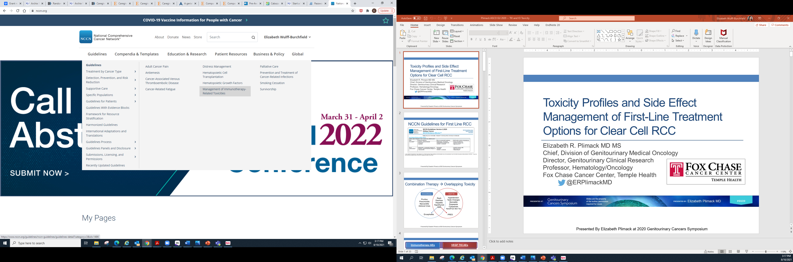

Slide 34
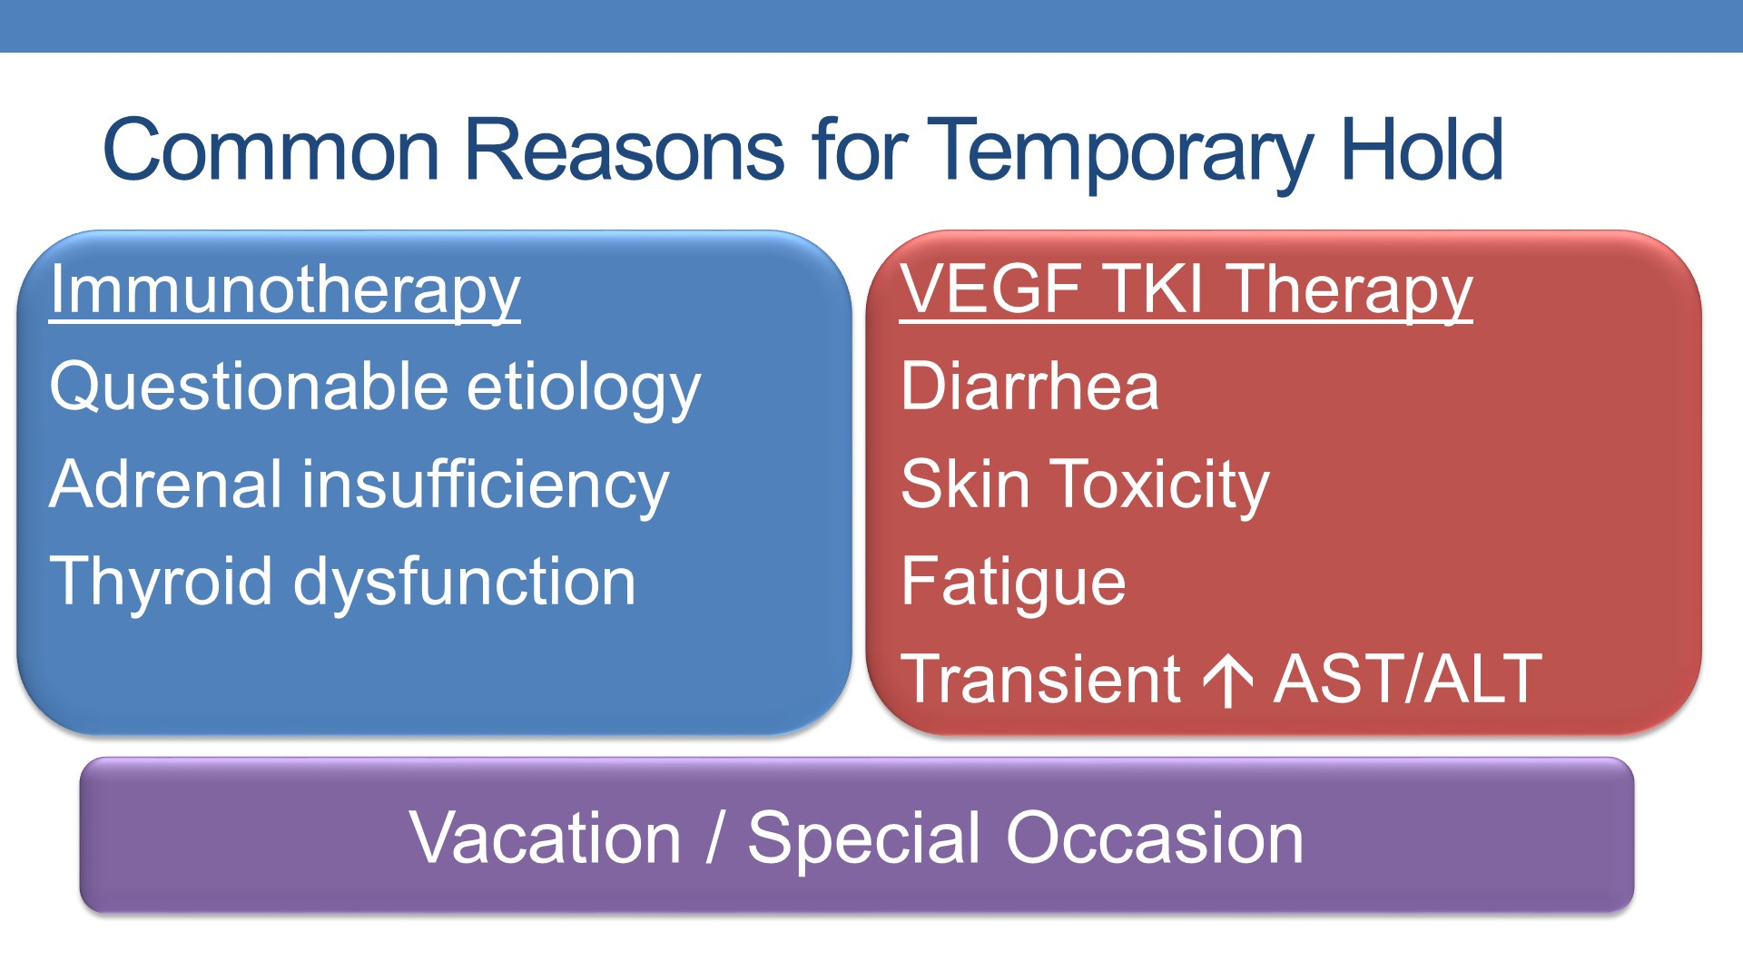
Plimack, E. Management of first-line treatment options for clear cell RCC. 2020 ASCO GU Symposium. San Francisco, CA.

Slide 35
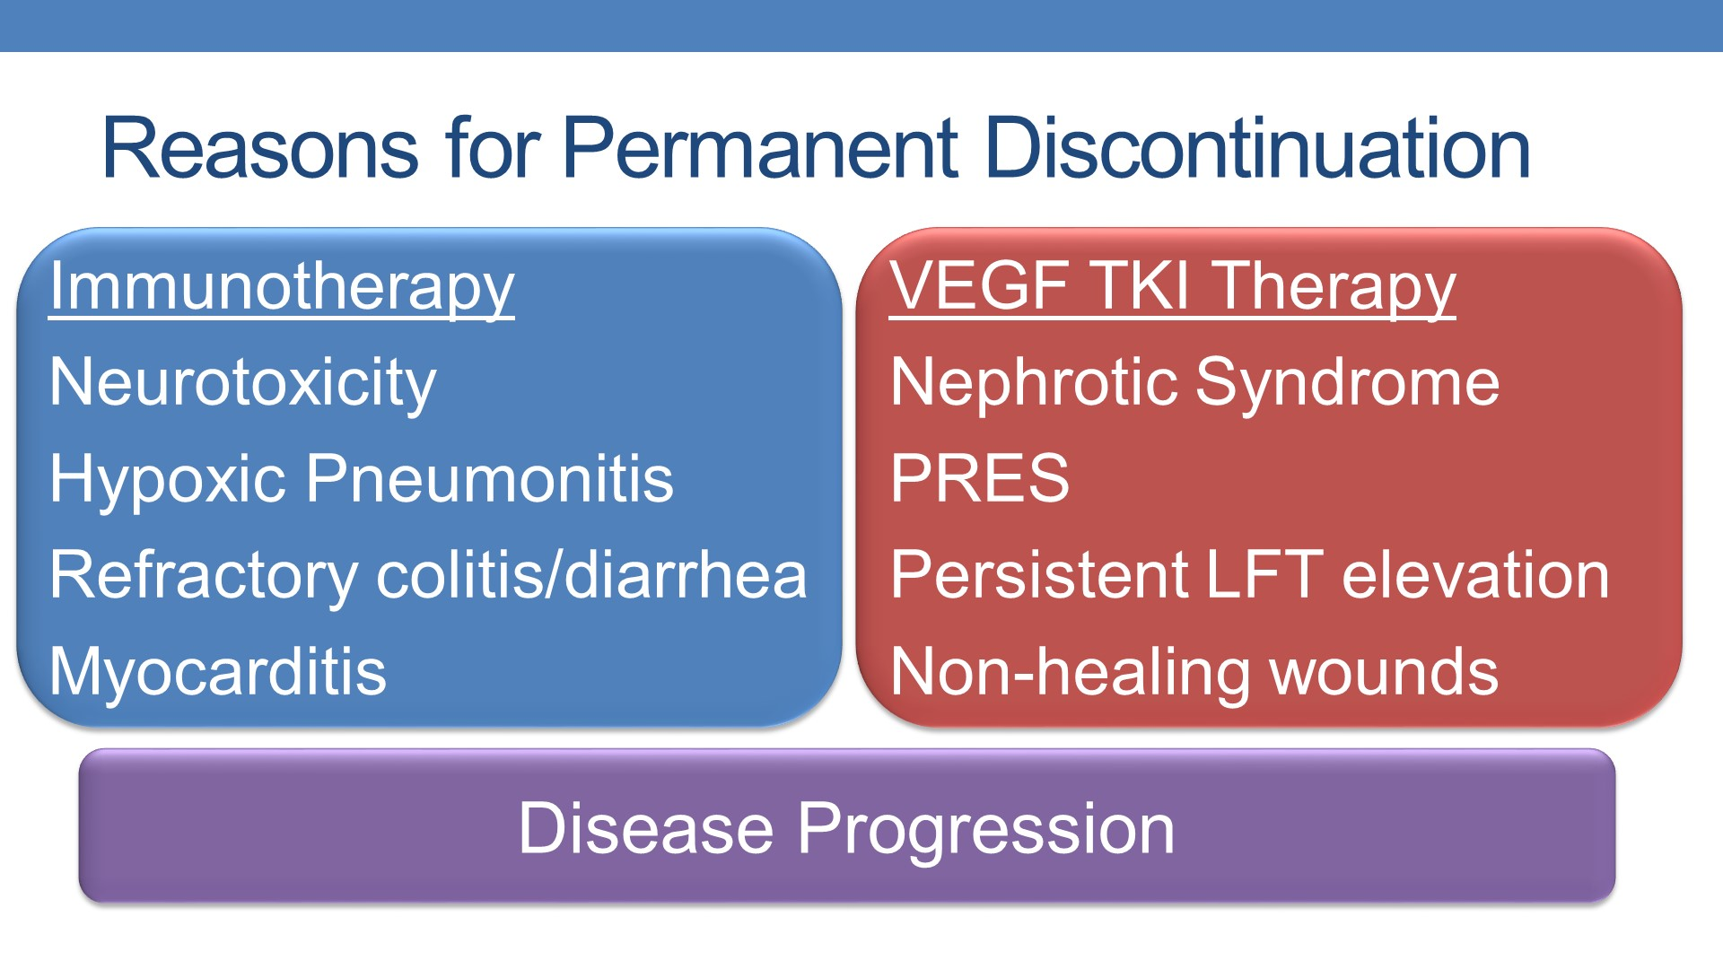
Plimack, E. Management of first-line treatment options for clear cell RCC. 2020 ASCO GU Symposium. San Francisco, CA.

Slide 36

Toxicity During TKI + IO Treatment:
Workup and Management Best Practices
Treat presumptively as a TKI symptom while continuing TKI
  Appropriate as a time-limited trial for low-grade symptoms
    Typically, 48-72 hours maximum
    May need ongoing supportive care (e.g., IV fluids) during this period
    Particularly helpful strategy for grade 1 diarrhea
      PRN or scheduled antidiarrheal agents are typically the starting strategy
  Some symptoms have treatments that are similar regardless of underlying etiology, such as hypothyroidism or some low-grade skin eruptions. In those cases, the same philosophy applies – treat the symptom while continuing treatment
Notes:
Jennifer – any other side effects for which we do this?

Slide 37
Toxicity During TKI + IO Treatment:
Workup and Management Best Practices
Holding treatment with TKI
  This is a key strategy that will often yield a great deal of information.
    Length of time that is necessary to assess improvement depends on the half-life of the TKI (e.g. Axitinib has half-life of ~6 hours, whereas Cabozantinib has a half-life of 55-99 hours).
  After holding TKI, follow up is key to determine response to this change.
    Can often be done by phone, patient portal messages, in-person visits, or telemedicine depending on how the risk of the situation is assessed.
  Lack of improvement indicates likely immune-mediated side effect.
Notes:
Jennifer -- sorry, I ran out of time here. If you can send slides back to me tonight, I will expand.,

Slide 38
Toxicity During TKI + IO Treatment:
Workup and Management Best Practices
Data-driven treatment as immune-mediated
  There is variability in management strategies depending on which symptom/side effect you’re treating, but steps include:
    Using CTCAE criteria to determine severity. Don’t “wing it” – use the criteria that trials and guidelines use.
    Use ASCO/SITC/NCCN guidelines to determine necessary workup and treatment
  We can “afford” to do this for mild or moderate symptoms, but usually not with severe symptoms.

Slide 39
Toxicity During TKI + IO Treatment:
Workup and Management Best Practices
Empiric treatment as immune-mediated
  Most appropriate for severe side effects or high-risk side effects that could be rapidly dangerous if immune-related:
    Pneumonitis
    Myocarditis
    Hepatitis
    Encephalitis
    Grade 3-4 colitis
    Any grade 4 symptom
  Despite empiric treatment as immune-mediated, still recommend continuing workup to determine etiology (e.g., BNP, troponin, endomyocardial biopsy for patient with suspected immune-mediated myocarditis).

Slide 40
Toxicity During TKI + IO Treatment:
Workup and Management Best Practices
Finally – keep the differential broad
  Despite emphasis on TKI and immune-mediated toxicities, patients on these therapies can still have infections, heart attacks, strokes, insect bites, pulmonary emboli, food poisoning, etc.
  Take the time – every time – to do a thorough history. It will pay off.

Slide 41
Toxicity During IO Treatment:
Workup and Management Best Practices
Treatment toxicity during combination immunotherapy (or single-agent) immunotherapy treatment is simpler and revolves around:
  (CTCAE) grading of side effects and using the appropriate guideline. That’s it!
  The prior information applies regarding decision-making re: data-driven versus empiric treatment of immune-mediated side effects.

Slide 42
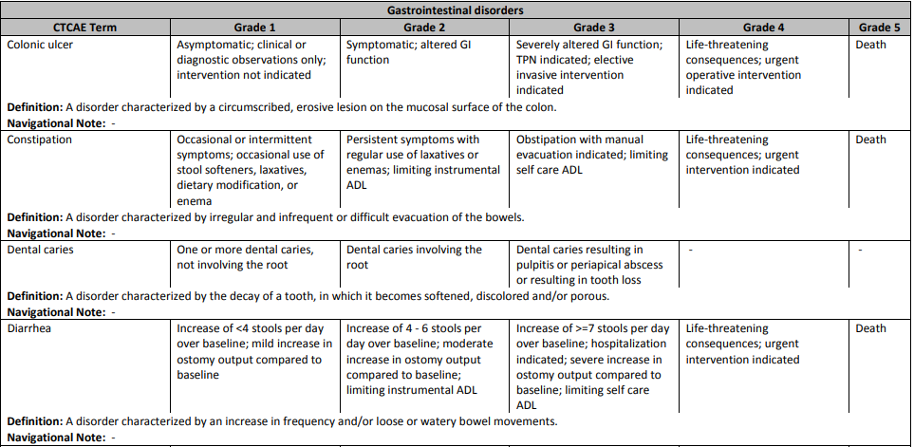
Case Study: Ms. Y
Notes:
Jennifer – can you describe what you would do to work up/manage her diarrhea?

Slide 43
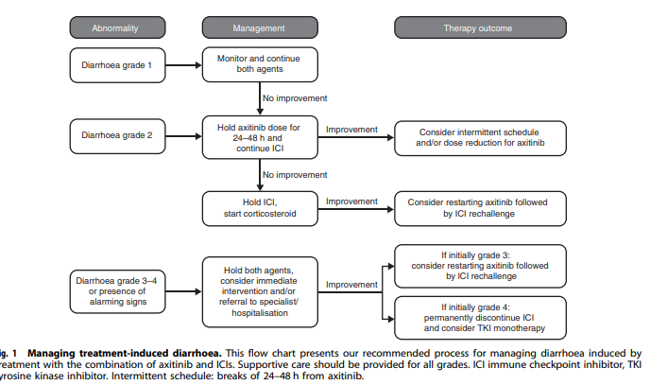
Case Study: Ms. Y
Grunwald V et al. Axitinib plus immune checkpoint inhibitor: evidence- and expert-based consensus recommendation for treatment optimisation and management of related adverse events. Br J Cancer. 2020.
Notes:
Jennifer – can you describe what you would do to work up/manage her diarrhea?

Slide 44
Case Study: Ms. Z
Notes:
Jennifer – can you describe what you would do to work up/manage her diarrhea

Slide 45
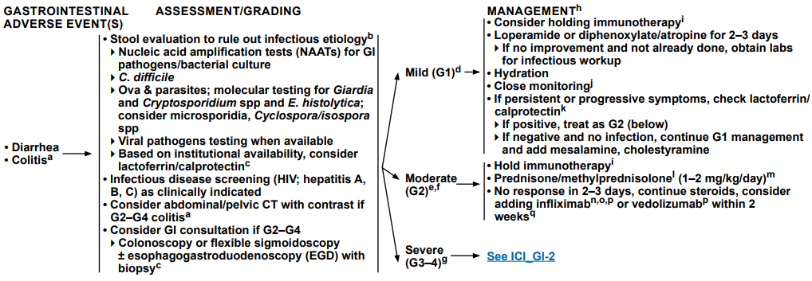
Case Study: Ms. Z
Thompson JA, et al. Management of Immunotherapy-Related Toxicities. NCCN version 3.2021. https://www.nccn.org/professionals/physician_gls/pdf/immunotherapy.pdf

Slide 46

Summary:
Side Effects from TKI + IO Combinations
If the attribution of a given symptom is in question, hold both agents
  If the symptom resolves quickly, it is probably due to TKI.
    Consider half-life of the medication when determining if a change has happened “quickly”
    It is often possible to restart the TKI at the next lowest dosing level when the symptom has resolved or improved to mild.
  If the symptom does not resolve or worsens, it is probably due to immunotherapy
    In that case, you would initiate immunotherapy management protocol according to grade of side effect.
    Immunotherapy can sometimes be re-initiated – check the guidelines each time.
    Can often resume the TKI even while patients are continuing their steroid taper and down to 10-20 mg per day of Prednisone.

Slide 47
Summary:
Side Effects from IO + IO Combinations
Evaluate the CTCAE grade
Use the guidelines – they’re available to help you!

Slide 48

Discussion & Questions

Slide 49


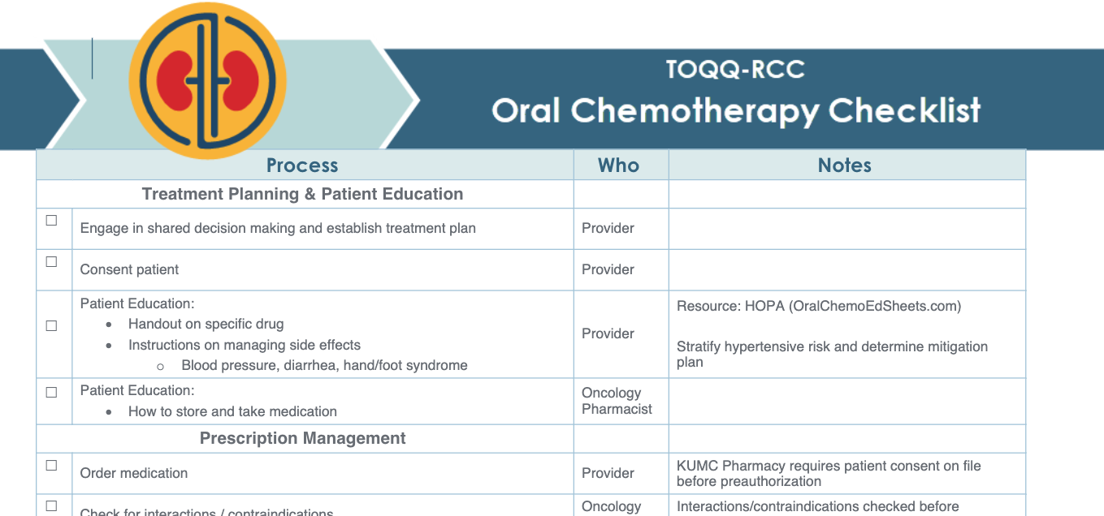
Next Steps!
Stay tuned for a Post-ECHO Survey coming soon!
Please complete the Workflow Analysis and send it to Catie (cknight2@kumc.edu).

Slide 50

Wrap-Up
Don’t forget to sign-in by putting your name in the chat box.
Activity Identification Code: 27torn
Due Date: Thursday, August 19, 2021 at 5:00 PM
Text the activity identification code to (828) 216-8114 or www.eeds.com
A recording of the previous session didactics and toolbox items are available on the MCA website on the Telementoring page. www.masoniccanceralliance.org

