Slide 1




Using Tele-Mentoring to Optimize Quality of Care and Quality of Life for Patients With Metastatic Kidney Cancer (TOQQ-RCC) ECHO Series
Facilitators: Elizabeth Wulff-Burchfield, MD,
Jennifer Klemp, PhD, MPH & Catie Knight, MPH
Session 2 Topic: Cytoreductive Nephrectomy in the CARMENA Era:
Shared decision-making for medical and surgical renal cell cancer treatment
Guest Speaker: Eugene Lee, MD

Slide 2
Agenda
Time | Presentation | Presenter
12:00– 12:10 pm | Welcome and Overview of Session | Catie Knight, MPH
12:10 – 12:30 pm | Case Presentation | Elizabeth Wulff-Burchfield, MD
12:30 – 12:55 pm | Didactic: Cytoreductive Nephrectomy in the CARMENA Era | Eugene Lee, MD Elizabeth Wulff-Burchfield, MD Jennifer Klemp, PhD, MPH
12:55 – 1:00 pm | Homework Wrap-up Announcements | Catie Knight, MPH

Slide 3
It’s nice to meet you!
Notes:
Pause Share Screen and ask participants to introduce themselves.

Slide 4
Conflict of Interest Disclosure
The following presenters and/or planning committee members do not have any relevant financial relationships with any proprietary entities producing, marketing, re-selling, or distributing healthcare goods or services consumed by, or used on patients related to the content of their presentation: Eugene Lee, MD; Catie Knight, MPH; Mary Beth Warren, MS, RN,
The following presenters and planning committee member has disclosed potentially relevant financial relationships with proprietary entities producing, marketing, re-selling or distributing healthcare goods or services consumed by, or used on, patients:
Elizabeth Wulff-Burchfield, MD received consulting fee from Astellas, Bristol Myers Squibb and Exelixis; owns stock in Immunomedics and Nektar
Jennifer Klemp, PhD, MPH received honoraria for consulting and speaking from Pfizer and honoraria for consulting from Astra Zeneca

Slide 5

Continuing Education Statement
Continuing education credit statements for TOQQ 5.14.21
Physicians: The University of Kansas Medical Center Office of Continuing Medical Education is accredited by the Accreditation Council for Continuing Medical Education (ACCME) to provide continuing medical education for physicians.
The University of Kansas Medical Center Office of Continuing Medical Education designates this live activity for a maximum of 1.0 AMA PRA Category 1 Credit(s)™. Physicians should claim only the credit commensurate with the extent of their participation in the activity.
APRN/RN: The University of Kansas Medical Center Area Health Education Center East is approved as a provider of CNE by the Kansas State Board of Nursing. This course offering is approved for 1.0 contact hours applicable for APRN, or RN relicensure. Kansas State Board of Nursing provider number: LT0056-0749. Mary Beth Warren, MS, RN, Coordinator.
Social Work: The University of Kansas Medical Center Area Health Education Center East, as an approved provider of continuing education by the Kansas Behavioral Sciences Regulatory Board presents this offering for a maximum of 1.0 hour credit applicable for relicensure of LASWs, LBSWs, LMSWs and LSCSWs. Kansas Provider Number 12-002. Mary Beth Warren, MS, RN, coordinator.
Attendance requirement for nurses and social workers Participants missing more than 10% of this offering will not receive continuing education credit
Certificates of attendance are available to other participants upon completion of documentation of attendance and evaluation

Slide 6
Continuing Education Credit & Certificate of Attendance
ACTIVITY IDENTIFICATION/SIGN IN CODE: 83cole
DEADLINE TO ENTER CODE AND COMPLETE EVALUATION: Thursday, May 20, 2021, at 5:00 PM
Using your mobile phone, you can text the activity identification code to (828) 216-8114.
OR
Accessing www.eeds.com from a mobile device or PC and entering the activity identification code;
OR
Downloading the eeds mobile app (iOS, Android) and using the activity identification code to sign-in to events.

Slide 7
Funding Source
This project is funded by a Pfizer Independent Grant for Learning and Change with additional support from The University of Kansas Cancer Center and Masonic Cancer Alliance.

Slide 8

Recording
This ECHO session will be recorded for educational and quality improvement purposes.
By participating in this ECHO clinic, you are consenting to be recorded.

Slide 9




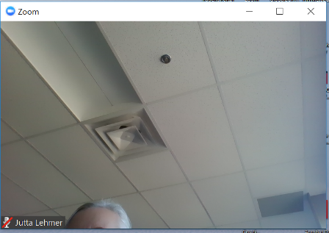
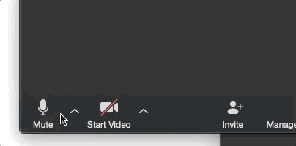


4
ECHO Clinic Tips
CAMERAS ON
Well-lit faces are
more engaging!
TESTING 1, 2, 3
Test both audio &
video in advance.
PARTICIPATE
Speak clearly, use the chat box, and actively engage.
MUTE YOURSELF
when you’re not speaking.

Slide 10

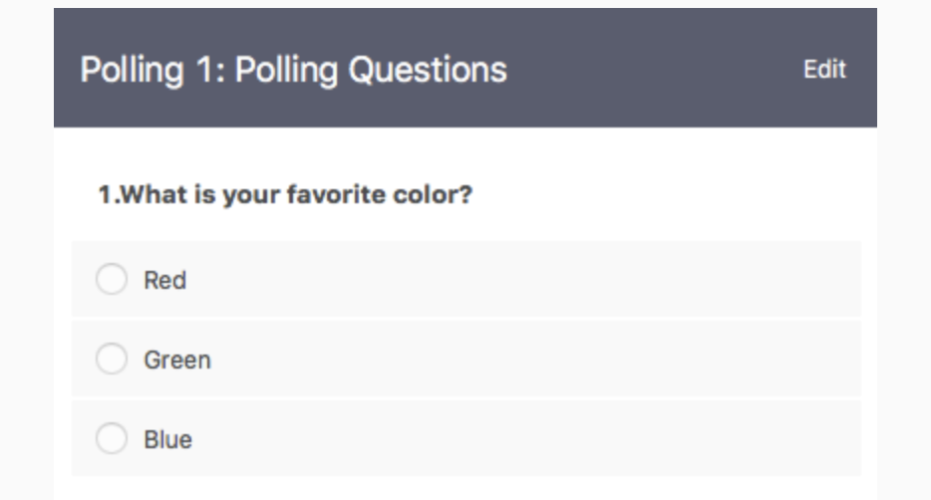
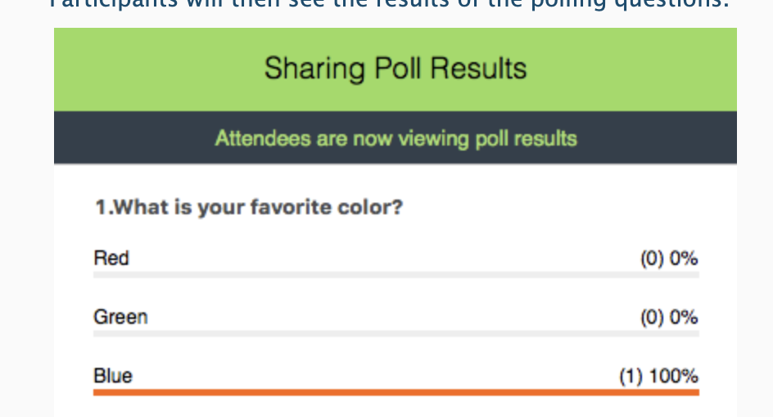

Polling Questions
Answer the poll question
See real-time results

Slide 11
Session 1 Learning Objective
Understand the role of cytoreductive nephrectomy as part of comprehensive renal cell carcinoma management.

Slide 12


Case Presentations & Patient Privacy
Goal: Protect patient privacy
Please only display or say information that does not identify a patient or that can not be linked to a patient.
Photos used in Case Study slides are freely-usable images from www.unsplash.com and not actual photos of known patients.
www.hipaa.com

Slide 13

Case Study: “Mrs. M”
73-year-old patient, “Mrs. M”
Demographics
  Born genetically female, self identifies as female with she/her pronouns
  Retired school nurse
  Married, has 2 sons who live nearby.
Comorbidities
  Type II diabetes, HgB a1c 7.5%, hypertension, hypothyroidism
Diagnosis History
  Developed self-limited, painless gross hematuria and saw PCP, who ordered CT a/p without contrast (“stone protocol”)
  CT revealed a 6.5 cm heterogeneous lower pole right kidney mass and borderline retroperitoneal lymphadenopathy Lower lung fields show 2 pulmonary nodules
  CT chest reveals bilateral pulmonary nodules, largest 2 cm
  Biopsy of lung nodule – clear cell renal cell carcinoma
Goals
  “To live to be 95 like [her] mother.”

Slide 14
Case study, cont.
Patient comes to clinic to establish medical oncology care.
  IMDC risk categorization: Intermediate-1 (based on de novo metastatic disease)
In addition to discussing systemic therapies Mrs. M notes that she has an upcoming consultation with a urologist “to get her kidney out.”
She says that she is willing to undergo nephrectomy if it’s important and asks for your recommendations.
What is the right answer in the post-CARMENA era?

Slide 15

But First, Terminology
Cytoreductive Nephrectomy
Radical nephrectomy for the purposes of disease control
Palliative Nephrectomy
Radical nephrectomy for the purposes of relieving suffering from a kidney cancer
(e.g., pain, bleeding, blood loss anemia)
Notes:
Given who is joining us today, it’s likely that many or all of you are aware of the distinction between cytoreductive and palliative nephrectomy, but we want to ensure that we’re all starting from the same baseline.

Slide 16
Surgical / Interventional Palliation of Kidney Mass
The data we will discuss about cytoreductive nephrectomy doesn’t necessarily apply to palliative nephrectomy.
If the patient’s functional status, quality of life, or tolerance of systemic cancer therapy is impacted by pain, bleeding, etc. from their primary tumor, then nephrectomy can provide meaningful improvement in symptoms.
Renal artery embolization can be considered if patients need palliation but aren’t healthy enough for surgery (or cannot stop systemic therapy long enough to recover).
  Post-embolization syndrome: flu-like symptoms, nausea, including fever, and can last 8-72 hours.
Notes:
Today’s focus will be on cytoreductive nephrectomy, but the general perspective on cytoreductive nephrectomy is that this is appropriate to pursue whenever it’s needed, assuming that the patient is a safe surgical candidate

Slide 17

Cytoreductive Nephrectomy
Retrospective analyses and then prospective, randomized trials conducted in the 1980s and 1990s (prior to targeted therapies for RCC) demonstrated improved overall survival in patients with metastatic RCC who underwent cytoreductive nephrectomy compared to patients who received up-front cytokine therapy¹.
Subsequent data in the targeted therapy era indicated favorable overall survival for patients treated with up-front cytoreductive nephrectomy².
The CARMENA and SURTIME prospective, randomized trials were designed to definitively assess up-front cytoreductive nephrectomy, albeit in the targeted therapy era³.
1. Flanigan RC, et al., N Engl J Med. 2001;345(23):1655; Mickisch GH,et al., Lancet. 2001;358(9286):966. 2. Heng DY, et al., Eur Urol. 2014 Oct;66(4):704-10. Epub 2014 Jun 13; Hanna N, et al., J Clin Oncol. 2016;34(27):3267. Epub 2016 Jun 20; ASCO GU 2020 (Accessed on April 28, 2020); Méjean A, et al., N Engl J Med. 2018;379(5):417. Epub 2018 Jun 3; The SURTIME Randomized Clinical Trial. Bex A, JAMA Oncol. 2019;5(2):164.
Notes:
Nephrectomy followed by interferon alfa-2b compared with interferon alfa-2b alone for metastatic renal-cell cancer. Flanigan RC, Salmon SE, Blumenstein BA, Bearman SI, Roy V, McGrath PC, Caton JR Jr, Munshi N, Crawford ED N Engl J Med. 2001;345(23):1655.
Radical nephrectomy plus interferon-alfa-based immunotherapy compared with interferon alfa alone in metastatic renal-cell carcinoma: a randomised trial. Mickisch GH, Garin A, van Poppel H, de Prijck L, Sylvester R, European Organisation for Research and Treatment of Cancer (EORTC) Genitourinary Group. Lancet. 2001;358(9286):966.
2) Cytoreductive nephrectomy in patients with synchronous metastases from renal cell carcinoma: results from the International Metastatic Renal Cell Carcinoma Database Consortium. Heng DY, Wells JC, Rini BI, Beuselinck B, Lee JL, Knox JJ, Bjarnason GA, Pal SK, Kollmannsberger CK, Yuasa T, Srinivas S, Donskov F, Bamias A, Wood LA, Ernst DS, Agarwal N, Vaishampayan UN, Rha SY, Kim JJ, Choueiri TK. Eur Urol. 2014 Oct;66(4):704-10. Epub 2014 Jun 13.
Survival Analyses of Patients With Metastatic Renal Cancer Treated With Targeted Therapy With or Without Cytoreductive Nephrectomy: A National Cancer Data Base Study. Hanna N, Sun M, Meyer CP, Nguyen PL, Pal SK, Chang SL, de Velasco G, Trinh QD, Choueiri TK. J Clin Oncol. 2016;34(27):3267. Epub 2016 Jun 20.
ASCO GU 2020: Cytoreductive nephrectomy for metastatic renal cell carcinoma treated with immune checkpoint inhibitors or targeted therapy. https://www.urotoday.com/conference-highlights/asco-gu-2020/asco-gu-2020-kidney-cancer/119346-asco-gu-2020-cytoreductive-nephrectomy-for-metastatic-renal-cell-carcinoma-treated-with-immune-checkpoint-inhibitors-or-targeted-therapy.html (Accessed on April 28, 2020).
3) Sunitinib Alone or after Nephrectomy in Metastatic Renal-Cell Carcinoma. Méjean A, Ravaud A, Thezenas S, Colas S, Beauval JB, Bensalah K, Geoffrois L, Thiery-Vuillemin A, Cormier L, Lang H, Guy L, Gravis G, Rolland F, Linassier C, Lechevallier E, Beisland C, Aitchison M, Oudard S, Patard JJ, Theodore C, Chevreau C, Laguerre B, Hubert J, Gross-Goupil M, Bernhard JC, Albiges L, Timsit MO, Lebret T, Escudier B. N Engl J Med. 2018;379(5):417. Epub 2018 Jun 3.
Comparison of Immediate vs Deferred Cytoreductive Nephrectomy in Patients With Synchronous Metastatic Renal Cell Carcinoma Receiving Sunitinib: The SURTIME Randomized Clinical Trial. Bex A, Mulders P, Jewett M, Wagstaff J, van Thienen JV, Blank CU, van Velthoven R, Del Pilar Laguna M, Wood L, van Melick HHE, Aarts MJ, Lattouf JB, Powles T, de Jong Md PhD IJ, Rottey S, Tombal B, Marreaud S, Collette S, Collette L, Haanen J. JAMA Oncol. 2019;5(2):164.

Slide 18
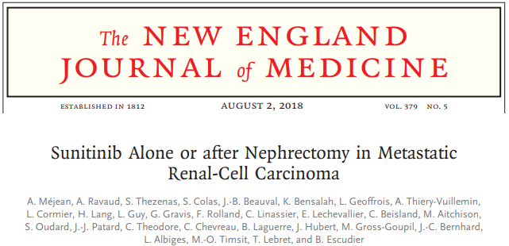

CARMENA
Randomized phase III trial
450 patients with metastatic RCC (intermediate/poor risk)
  Up-front cytoreductive nephrectomy followed by Sunitinib vs. Sunitinib alone (no up-front nephrectomy)
Primary endpoint = OS, non-inferiority design
Results
  Sunitinib alone is non-inferior to cytoreductive nephrectomy + Sunitinib
  OS (surprisingly) longer in Sunitinib-alone group (~18 months) vs. cytoreductive nephrectomy + Sunitinib (~14 months)
  Follow-up analysis indicates that up-front cytoreductive nephrectomy may be beneficial for patients with only one IMDC risk factor⁴
4. ASCO 2019: Update on the CARMENA trial with focus on intermediate IMDC-risk population
Notes:
ASCO 2019: Update on the CARMENA trial with focus on intermediate IMDC-risk population: Cytoreductive nephrectomy in metastatic renal cancer. Available at: https://www.urotoday.com/conference-highlights/asco-2019-annual-meeting/asco-2019-kidney-cancer/113069-asco-2019-cytoreductive-nephrectomy-in-metastatic-renal-cancer-update-on-carmena-trial-with-focus-on-intermediate-imdc-risk-population.html (Accessed on April 28, 2020).

Slide 19
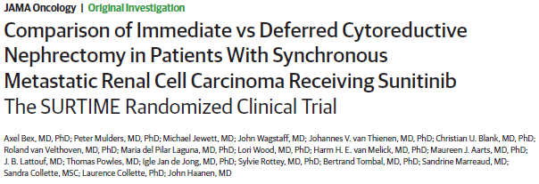
SURTIME
Randomized phase III trial
99 patients (closed prematurely due to low accrual)
  Up-front cytoreductive nephrectomy followed by Sunitinib versus 3 cycles of Sunitinib followed by cytoreductive nephrectomy (if no progression of disease on initial 3 cycles)
Primary endpoint: progression-free survival
Results
  28-week progression-free rate was identical between the two arms (42% vs. 43%)
  ITT overall survival data revealed median OS of 15 months in up-front nephrectomy arm versus 32.4 months in delayed nephrectomy arm
  14 patients (29%) in delayed nephrectomy arm had progression during initial Sunitinib period and did not undergo nephrectomy
Notes:
It’s important to take the results with a grain of salt, because this trial accrued 99 out of a planned 458 patients

Slide 20

Knowledge Gaps Persist
Even with RCT data, decision-making about cytoreductive nephrectomy isn’t clear.
Application of CARMENA data is fraught
  TKI monotherapy is no longer standard up-front systemic therapy; we need data about cytoreductive nephrectomy in in era of first-line checkpoint inhibitor
  CARMENA sample included a high proportion of patients with poor-risk disease

Slide 21
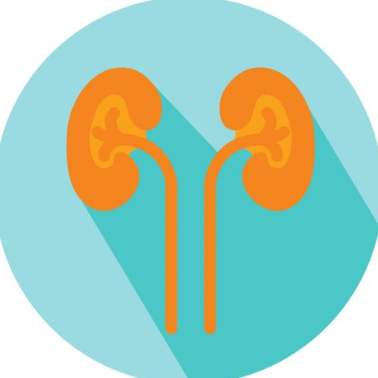
Knowledge Gaps Persist
Three ongoing clinical trials that may help bridge the gaps…
NORDIC-SUN (NCT 03977571)
Up-front Nivo + Ipi, then randomization to delayed nephrectomy followed by Nivolumab vs.maintenance Nivolumab alone
CYTOSHRINK (NCT 04090710)
Up-front Nivo + Ipi vs. Nivo + Ipi plus SBRT to primary kidney mass
PROBE (NCT 04510597)
Up-front immunotherapy combination treatment; for patients with partial response or stable disease, randomization to continued systemic therapy vs. nephrectomy followed by standard systemic therapy

Slide 22
Let’s take a poll!
Have you seen a drop in the proportion of patients with kidney cancer who have had cytoreductive nephrectomy since 2018?
Yes
No

Slide 23
Back to the Case…
Recommendation:
  Proceed with her urology visit to discuss the role of nephrectomy given that she only has 1 IMDC risk factor
Mrs. M’s questions:
  When is the best time to have this surgery?
  Is it safe even after I’ve started treatment?

Slide 24

Safety of Deferred Nephrectomy
In addition to the CARMENA and SURTIME trials exploring the value of cytoreductive nephrectomy in metastatic disease, multiple studies (both retrospective and prospective) have evaluated the safety of nephrectomy after up-front targeted therapy.
Several of these studies have evaluated so-called “downstaging” TKI therapy to facilitate partial nephrectomy for or radical nephrectomy for otherwise unresectable kidney masses.
  Median tumor reduction (by RECIST) ranged from 17-28% in up to 45% of patients⁵
In these studies, there has been no evidence of increased complication rate, blood loss, or operating time.
5. Lebacle C, et al., BJU Int 123:804-810, 2019.; Karam JA, et al., Eur Urol 66:874-80, 2014.
Notes:
Lebacle C, Bensalah K, Bernhard JC, et al: Evaluation of axitinib to downstage cT2a renal tumours and allow partial nephrectomy: a phase II study. BJU Int 123:804-810, 2019
Karam JA, Devine CE, Urbauer DL, et al: Phase 2 trial of neoadjuvant axitinib in patients with locally advanced nonmetastatic clear cell renal cell carcinoma. Eur Urol 66:874-80, 2014

Slide 25
Best-Laid Plans?
However, some report up-front immunotherapy may be another story…
Some series have described extensive local desmoplastic reaction to immunotherapy
Two largest series demonstrate conflicting data:
  One series demonstrating surgeons experienced difficulty identifying dissection planes in 81.8% of cases (n=11), as well as longer mean operative time, greater blood loss, and longer hospital stay of 7 days than typical of radical nephrectomy⁶
  Another series showed no increase in blood loss, operative time, or hospital stay⁷
Duration of ICI therapy has been proposed as an important factor
  Immunotherapy duration was longer (40 weeks) in series reporting operative challenges than in series without (1.5 cycles*)
    *although 3/10 patients in this series had >20 weeks of ICI therapy
6. Pignot G, Eur Urol 77:761-763, 2020; 7. Singla N, Urologic Oncology 37:924-931, 2019
Notes:
1) Pignot G, Thiery-Vuillemin A, Walz J, et al: Nephrectomy After Complete Response to Immune Checkpoint Inhibitors for Metastatic Renal Cell Carcinoma: A New Surgical Challenge? Eur Urol 77:761-763, 2020
2) Singla N, Elias R, Ghandour RA, et al: Pathologic response and surgical outcomes in patients undergoing nephrectomy following receipt of immune checkpoint inhibitors for renal cell carcinoma. Urologic Oncology: Seminars and Original Investigations 37:924-931, 2019

Slide 26

Best-Laid Plans, cont.
Conflicting reports clearly indicate a need to assess surgical complexity and complication rate in patients treated with up-front checkpoint inhibitor therapy in current and forthcoming clinical trials assessing neoadjuvant checkpoint inhibitor therapy (or up-front checkpoint inhibitor therapy in the setting of intermediate and poor risk metastatic RCC).

Slide 27
More to Come
Multiple ongoing and forthcoming clinical trials will further clarify clinical best practices in this situation:
Clinical and pathologic response rates from new applications of immunotherapy combination treatments
Clinical and prognostic implications of pathologic and radiographic responses
Predictive and prognostic biomarkers from correlative studies
Long-term outcomes in patients whose cancer can be down-staged with systemic therapy combinations

Slide 28

Let’s take a poll!
Are you currently comfortable referring patients for delayed/deferred nephrectomy (or have you already done this)?
Yes
No
Add your rationale in the chat box!
Notes:
Other factors that can influence choice of treatment – cost of oral cancer medications
Even if we are able to identify the ideal treatment regimen for a patient, the cost of treatment, particularly for oral medications, can create barriers.
In your practice, have you encountered circumstances when patients were unable to take recommended treatments due to the cost of oral medications (for any cancer, not just kidney cancer)?
Yes
No
If you’ve been able to overcome some of these barriers, please share with us some of your strategies in the chat box.

Slide 29
Back to the Case…
Mrs. M meets with her urologist, after which you hold an interdisciplinary discussion with this physician.
You decide to proceed with standard immunotherapy-containing combination therapy but perform restaging at 3 months, at which time you will make the decision about nephrectomy.
During this discussion you and your urologist colleague decide that you should develop consistent criteria to use in both of your practices for considering cytoreductive nephrectomy.
What should be included?

Slide 30

Bottom Line: Cytoreductive Nephrectomy
“Always” consider up-front cytoreductive nephrectomy
In oligometastatic disease (particularly w/ lung metastases only) if the patient can undergo metastatectomy for all sites of disease.
“Sometimes” consider up-front cytoreductive nephrectomy
Patients with risk categorization of IMDC-1
Minimally symptomatic, good performance status
Lung metastases and/or lymph node metastases
Deferred nephrectomy
IMDC intermediate-2 or poor risk if stable disease or partial response after appx 3-4 months of treatment
And remember, palliative nephrectomy is medically and ethically appropriate when needed.

Slide 31

Discussion & Questions

Slide 32
Announcements
Friday, June 11th @ Noon
Immunotherapy Toxicity Monitoring and Management:
Including with regards to at-home immunotherapy administration
Guest Speaker: Gary Doolittle, MD

Slide 33

Wrap-Up
Don’t forget to sign-in by putting your name in the chat box.
Activity Identification Code: 83cole
Due Date: Thursday, May 20, 2021, at 5:00 PM
Text the activity identification code to (828) 216-8114 or www.eeds.com
A recording of the didactic and toolbox items from today’s session will be emailed to you next week.

